Slide 1
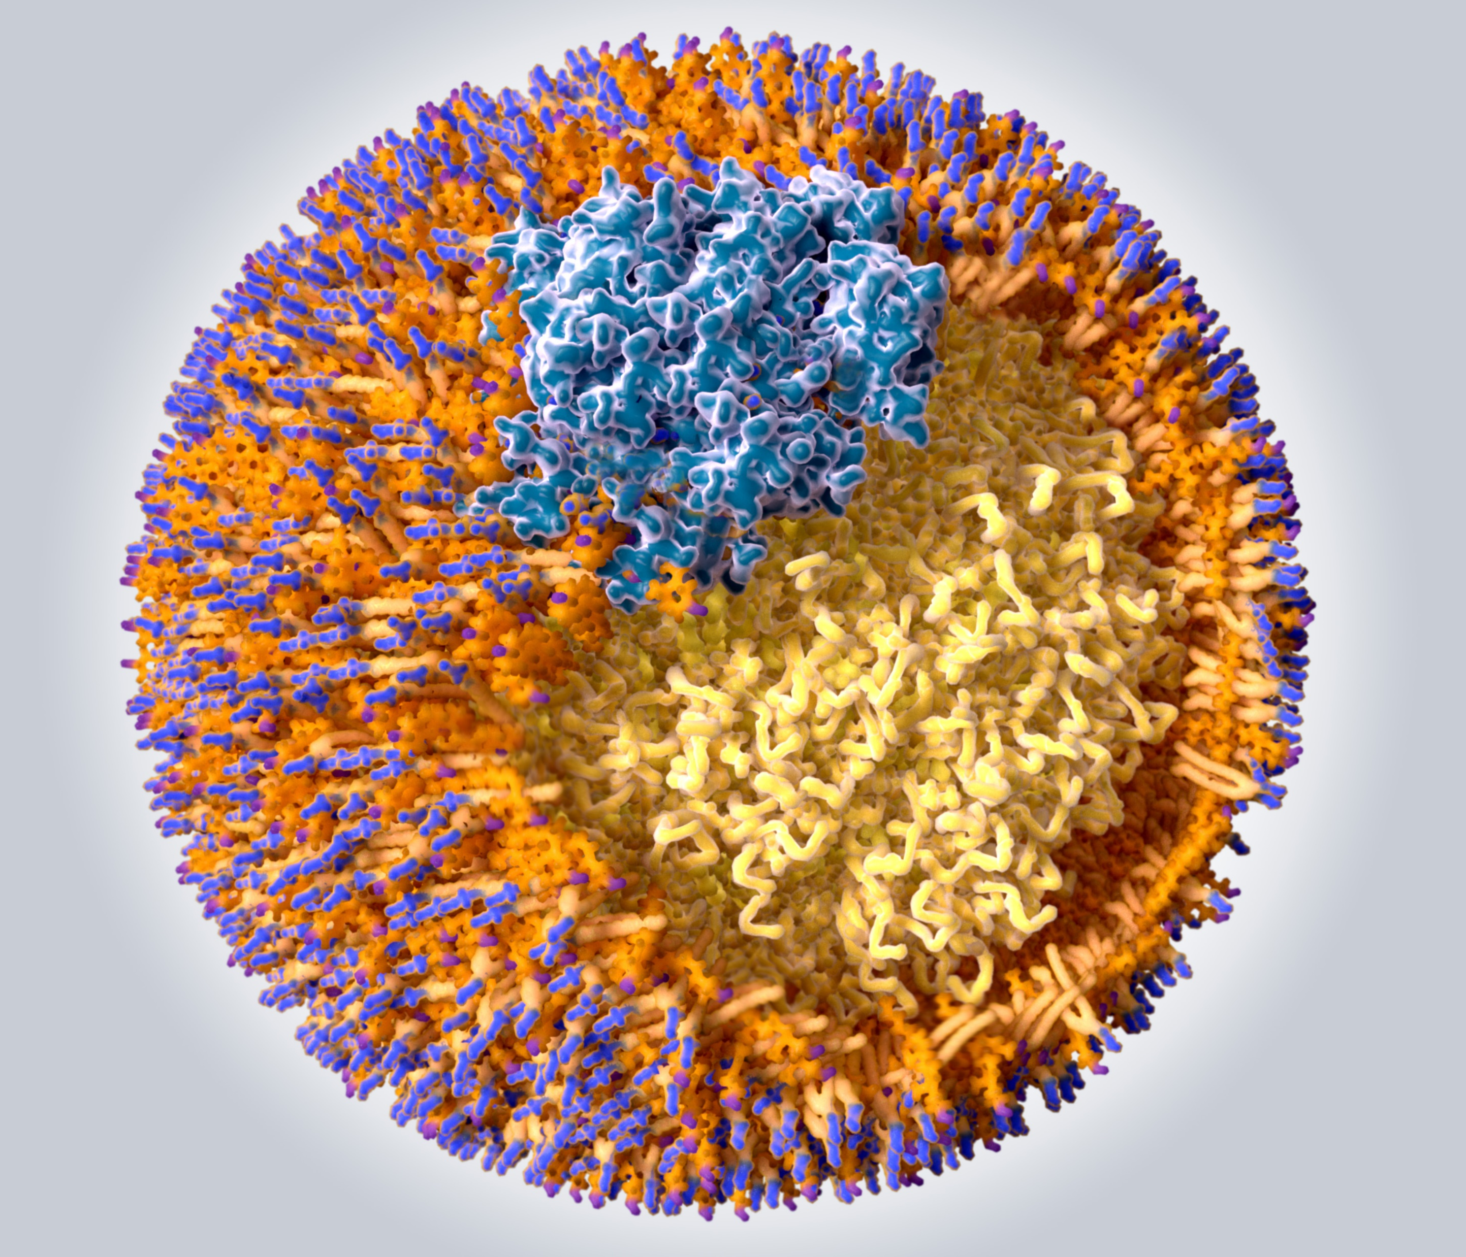

Dyslipidemia in Primary Care: Addressing Barriers to Optimal Lipid Management

Slide 2

Presenter Disclosure
Presenter - [presenter name]
Relationships with financial sponsors:
Grants/Research Support:
Speakers Bureau/Honoraria:
Consulting Fees:
Patents:
Other:

Slide 3
Disclosure of Financial Support
This program has received financial support from Amgen Canada in the form of an educational grant.
This program has received in-kind support from Amgen Canada in the form of logistical support.
Potential for conflict(s) of interest:
[Presenter] has received [payment/funding, etc.] from [organization supporting this program AND/OR organization whose product(s) are being discussed in this program].
Amgen Canada developed, licenses, distributes and benefits from the sale of a product that will be discussed in this program

Slide 4
Mitigating Potential Bias
The Canadian Heart Research Centre (CHRC) assesses conflict of interest with its instructors, planners, managers and other individuals who are in a position to control the content of CME activities. All relevant conflicts of interest that are identified are thoroughly vetted by the CHRC for fair balance, scientific objectivity of studies utilized in this program, and patient care recommendations. The CHRC is committed to providing its learners with high quality CME activities and related materials that promote improvements or quality in healthcare and not a specific proprietary business interest of a commercial interest.
The speaker had provided a full disclosure in advance of the program. The scientific content of the program is evidence based and all content related to pharmacotherapy is within product label. The program has been peer reviewed and is nationally accredited by the College of Family Physicians of Canada.
[Presenter] has provided his disclosure information at the start of this presentation.

Slide 5

Program Development
This program was planned by the Canadian Heart Research Centre, a not-for-profit academic organization to achieve scientific integrity, objectivity, and balance.
This program has received an educational grant and in-kind support from Amgen Canada

Slide 6
Learning Objectives
Upon completion of this activity, participants will be able to:
01
Recognize the centrality of LDL-C and its cumulative exposure to increased risk of ASCVD events
02
Evaluate the limitations of current lipid lowering agents and assess recommendations for lipid lowering agents beyond, or in addition to, statin therapy for high-risk patient
03
Identify those patients who would benefit from additional therapy beyond statins to reduce CV risk
04
Explain the latest clinical data for PCSK9 inhibitors and use effective strategies to integrate the data into clinical care to reduce the risk for CV events
05
Appropriately apply best guideline practice recommendations into routine clinical practice based on specific patient characteristics
ASCVD: Atherosclerotic cardiovascular disease

Slide 7
Centrality of LDL Cholesterol

Slide 8
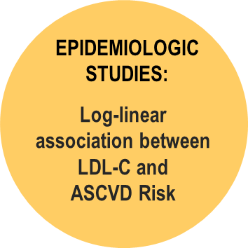
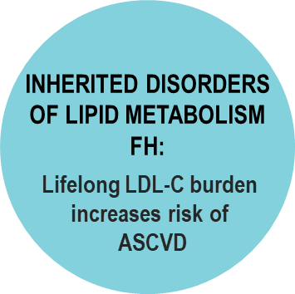
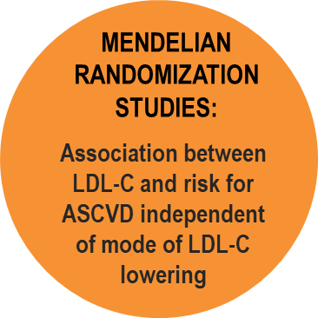
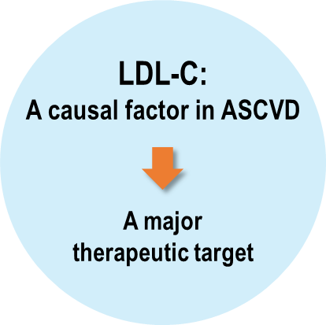
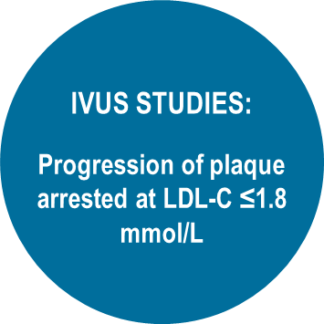
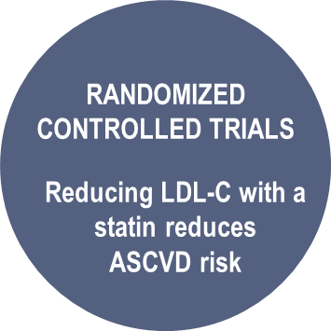
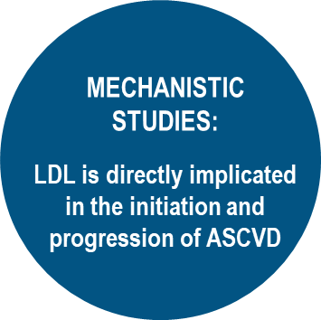
LDL-C is Causal for ASCVD*
ASCVD: Atherosclerotic cardiovascular disease
FH: Familial Hypercholesterolemia

Slide 9
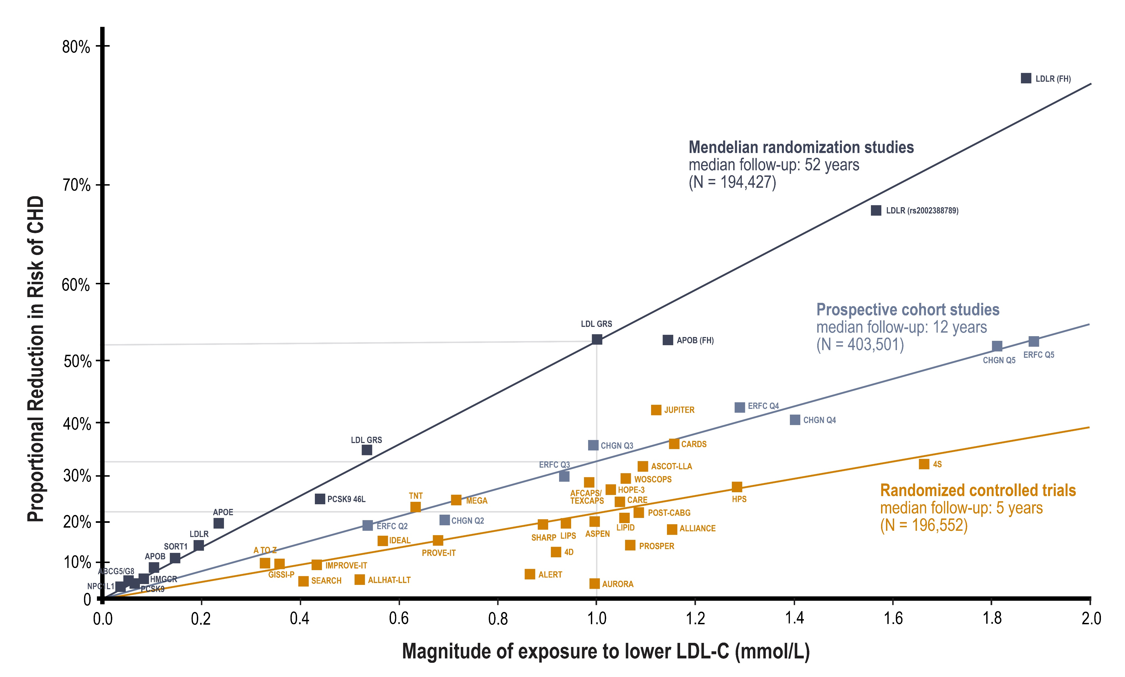
Circulating LDL-C is Strongly Associated with an Increase in the Risk of ASCVD Events
Continuous, dose-dependent and log-linear causal association between the magnitude of the absolute change in LDL-C level and the lifetime risk of CHD
ASCVD: Atherosclerotic cardiovascular disease
Adapted from Ference BA et al. Eur Heart J. 2017 Apr 24. doi: 10.1093/eurheartj/ehx144.

Slide 10
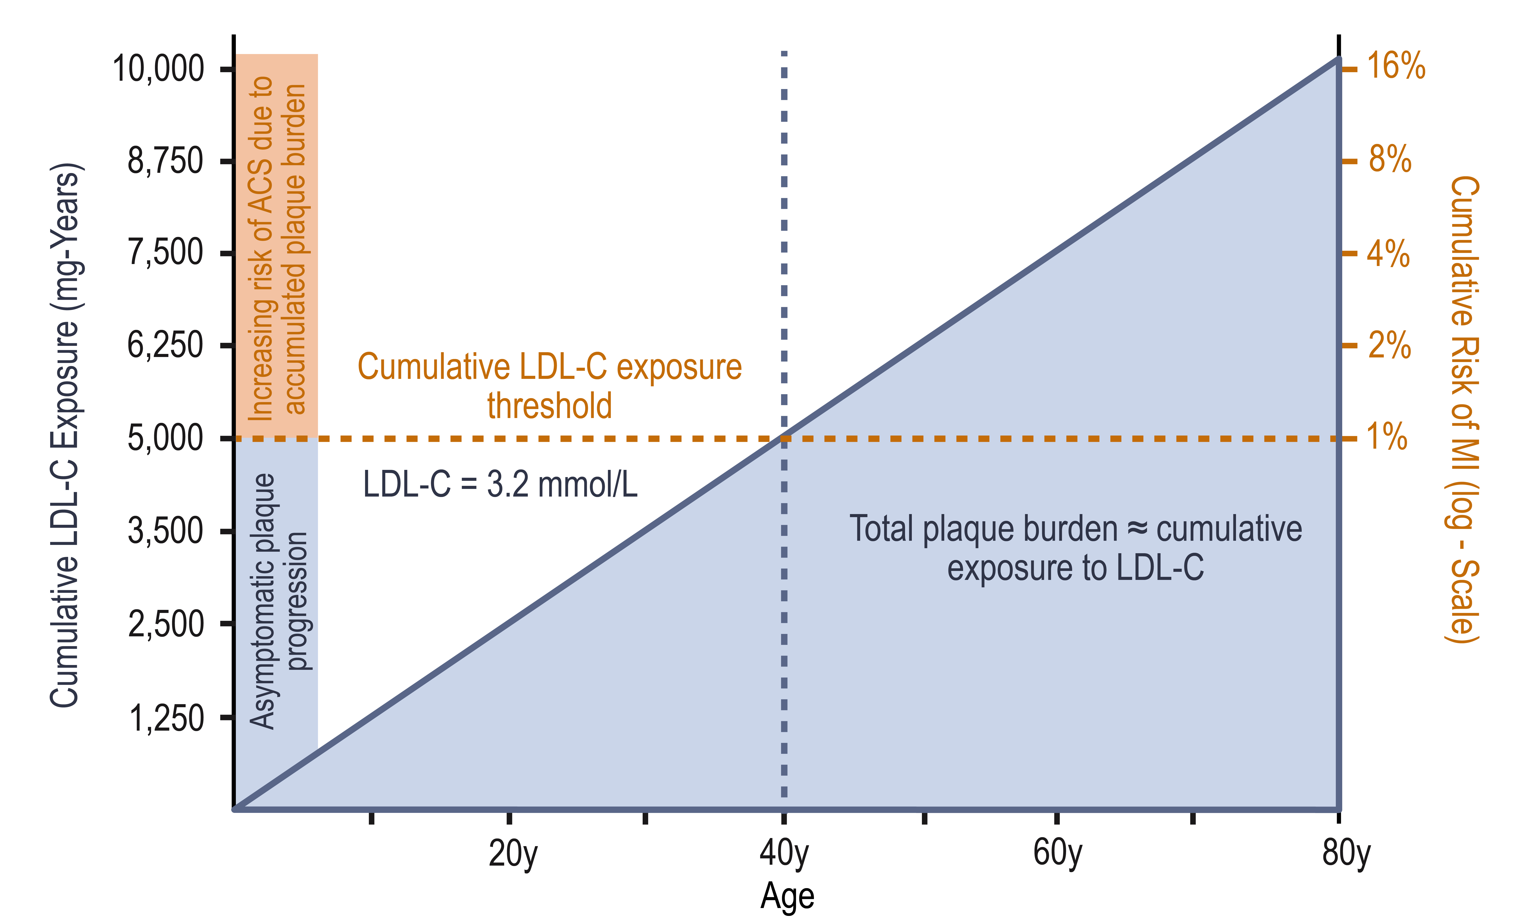
Effect of Cumulative Exposure to LDL on Plaque Burden and Risk of Cardiovascular Disease
Cumulative LDL-C Exposure (mmol-Years)
259
207
194
162
129
91
65
32
Ference BA, et al. J Am Coll Cardiol 2018;72:1141–56
Notes:
Speaker Notes:
The solid blue line represents constant exposure to plasma low-density lipoprotein cholesterol (LDL-C) of 125 mg/dl. Cumulative low-density
lipoprotein cholesterol exposure is derived by multiplying age by plasma low-density lipoprotein cholesterol. The shaded area under the
solid blue line represents the accumulating total plaque burden (which is directly proportional to both age and cumulative exposure to lowdensity
lipoprotein cholesterol). The horizontal orange dashed line represents the cumulative low-density lipoprotein cholesterol
(and therefore total plaque burden) needed to result in a measurable increase in the risk of myocardial infarction (MI). It is derived by
multiplying age 40 years (age at which the cumulative incidence of myocardial infarction exceeds 1%) by 125 mg/dl (plasma low-density
lipoprotein cholesterol level). Beyond this threshold, if the plasma low-density lipoprotein cholesterol level remains constant, then both
cumulative low-density lipoprotein cholesterol exposure and total plaque burden increase linearly, but the risk of myocardial infarction rises
log-linearly (and is shown on the right-hand side y-axis expressed on the log or “doubling scale”). ACS ¼ acute coronary syndrome.

Slide 11
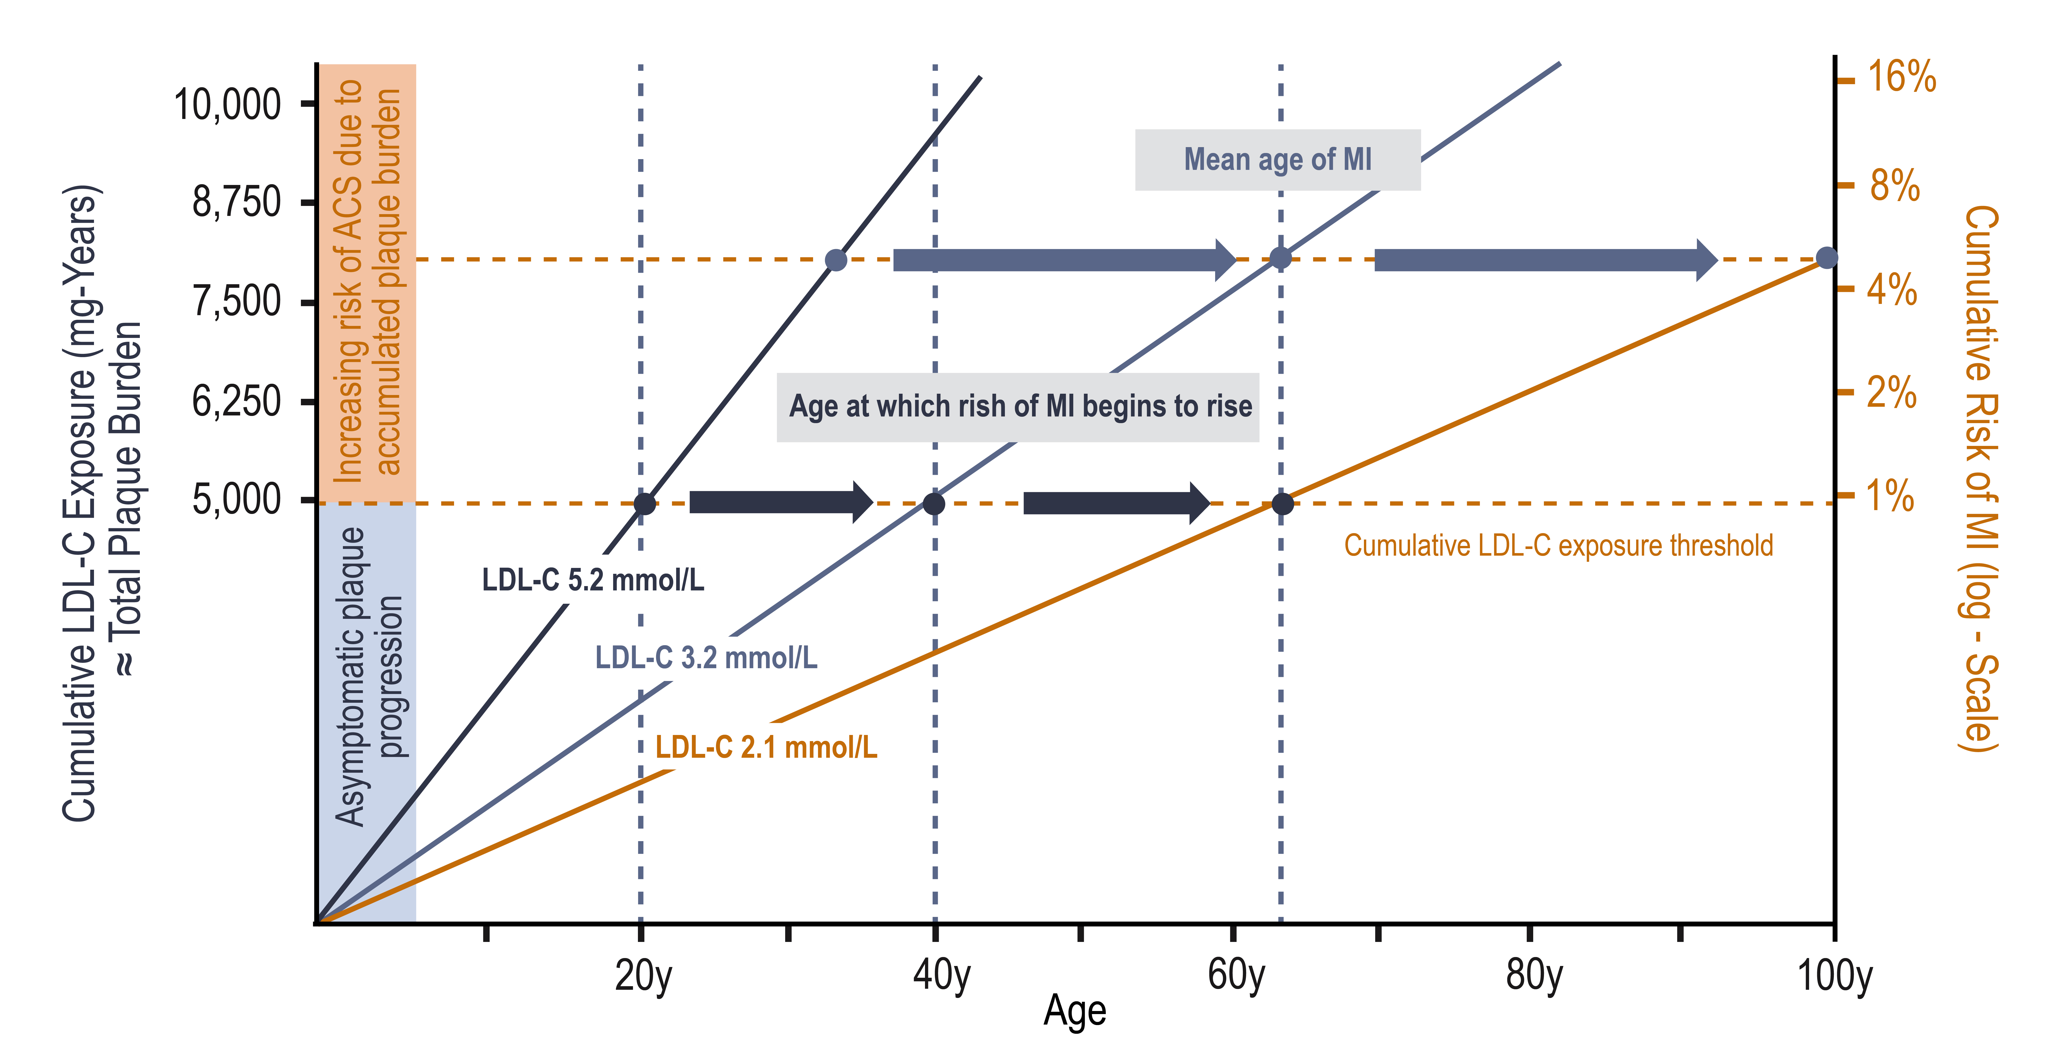
Cumulative Effect of LDL on Risk of Atherosclerotic Cardiovascular Disease
Cumulative LDL-C Exposure (mmol-Years)
≈ Total Plaque Burden
259
207
194
162
129
Ference BA, et al. J Am Coll Cardiol 2018;72:1141–56
Notes:
Speaker Notes:
The solid dark blue line represents a low-density lipoprotein cholesterol (LDL-C) level of 200 mg/dl / 5.17 mmol/L throughout life. The solid light blue line
represents a low-density lipoprotein cholesterol level of 125 mg/dl / 3.23 mmol/L throughout life. The orange line represents a low-density lipoprotein
cholesterol level of 80 mg/dl / 2.06 mmol/L throughout life. Cumulative low-density lipoprotein cholesterol exposure is derived by multiplying age by
plasma low-density lipoprotein cholesterol. Cumulative risk of myocardial infarction (MI) is measured on the log (“doubling”) scale. The
dark blue dots represent the age at which persons with lifetime exposure to 200 mg/dl, 125 mg/dl, and 80 mg/dl, (5.17 mmol/L 3.23 mmol/L, 2.06 mmol/L) respectively, exceeds the
5,000 mg-years threshold of cumulative exposure to low-density lipoprotein cholesterol beyond which the cumulative lifetime risk of
myocardial infarction exceeds 1%. The light blue dots represent the average age that persons with lifetime exposure to 200 mg/dl, 125 mg/dl, and
80 mg/dl, (5.17 mmol/L 3.23 mmol/L, 2.06 mmol/L) respectively, experience a myocardial infarction (or approximately 8,000 mg-years of cumulative low-density lipoprotein
cholesterol exposure). The figure shows that lower cumulative exposure to low-density lipoprotein cholesterol can slow plaque progression
and delay the onset of myocardial infarction and other acute coronary syndromes (ACS).

Slide 12
Are we doing enough?
Guidelines vs. Real World

Slide 13

2016 CCS Lipid Guidelines Recommend: Targeting Lower LDL-C to Lower the Risk for CV Events
TREATMENT TARGETS:
STATIN INDICATED CONDITIONS
LDL-C consistently <2.0 mmol/L or >50% reduction
Consider <1.8 mmol/L in patients with clinical atherosclerosis
Apo B ≤0.80 g/L or non-HDL-C ≤2.6 mmol/L can be considered as alternative treatment targets
(those who will benefit the most):
Clinical atherosclerosis*
Abdominal aortic aneurysm
Most diabetes mellitus
CKD (age >50 years)
LDL-C ≥5.0 mmol/L
*Clinical atherosclerosis, i.e., previous MI, or coronary revascularization by PCI or CABG surgery, other arterial revascularization procedures, angina pectoris, cerebrovascular disease including TIA, or peripheral arterial disease (claudication and/or ABI <0.9)
ABI, ankle brachial index; Apo B, apolipoprotein B; CABG, coronary artery bypass graft surgery; CCS, Canadian Cardiovascular Society; CKD, chronic kidney disease; CV, cardiovascular; HDL-C, high-density lipoprotein cholesterol; LDL-C, low-density lipoprotein cholesterol; MI, myocardial infarction; PCI, percutaneous coronary intervention; TIA, transient ischemic attack.
Anderson TJ et al. 2016;32:1263-1282
Notes:
Speaker Notes:
In the first year of the trial, Koren and colleagues randomly assigned patients in a 2:1 ratio to open-label treatment with evolocumab 420 mg per month plus standard-of-care treatment compared with standard-of-care treatment only. More patients (n = 882) were enrolled in the evolocumab arm compared with the standard-of-care treatment arm (n = 442). After the first year, all patients received extended, monthly evolocumab therapy plus standard-of-care treatment. The researchers examined the impact of evolocumab on lipids and safety outcomes, including antidrug antibodies, over the 5-year study period.
Treatment with evolocumab decreased median LDL cholesterol by 61% in year 1, 59% in year 2, 59% in year 3, 59% in year 4 and 58% in year 5. The analysis included 818 patients in year 1, 1,122 patients in year 2, 1,059 patients in year 3, 1,012 patients in year 4 and 870 patients in year 5.
Adverse events occurred in 79% of patients in year 1, 74% of patients in year 2, 71% of patients in year 3, 67% of patients in year 4 and 65% of patients in year 5. Serious adverse events occurred in 7%, 7%, 8%, 7% and 7%, respectively, of patients over the same time period. Adverse events that resulted in drug discontinuation occurred in 2.8%, .8%, 1.3%, 1% and .2% of patients each year from years 1 to 5.
Transiently positive tests for binding antidrug antibodies during year 1 were seen in two patients in the standard-of-care arm and two patients in the evolocumab arm. There were no subsequent or novel reports of binding or neutralizing antidrug antibodies noted after that point, according to Koren and colleagues.
“In OSLER-1, the longest study of a PCSK9 inhibitor to date, evolocumab consistently reduced LDL cholesterol with no increase in adverse events over time and no neutralizing antibodies,

Slide 14

A 1 mmol/L reduction of LDL-C reduces the risk of CV events by?
~18%
~22%
~25%
~27%

Slide 15
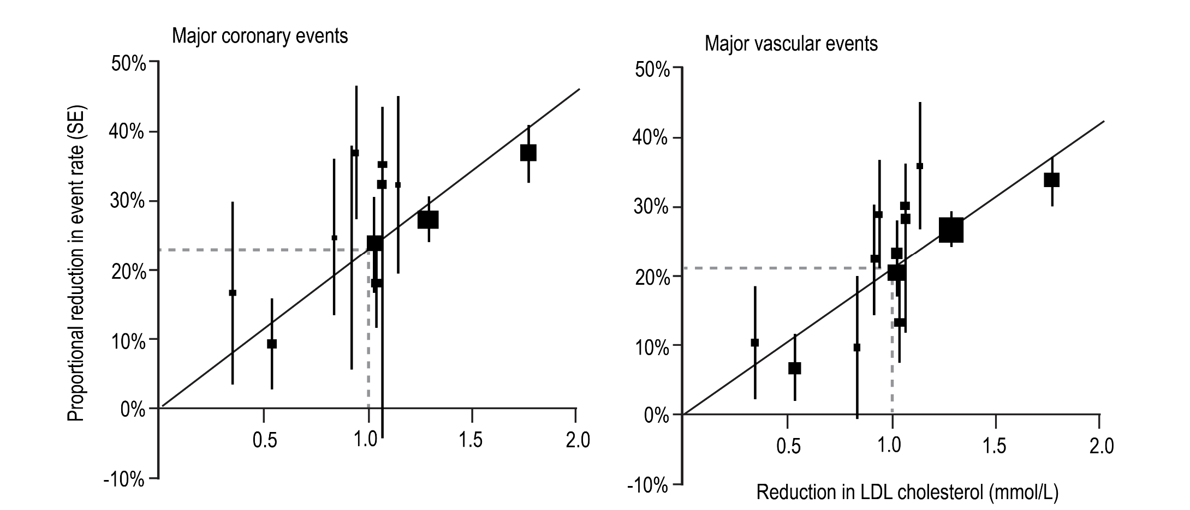
Lessons from Statin Trials
Meta-analysis of statin trials:
1 mmol/L reduction of LDL-C = ~22% reduction in the risk of CV events
Chen et al. Can J Cardiol. 2019. 35:884-891.

Slide 16
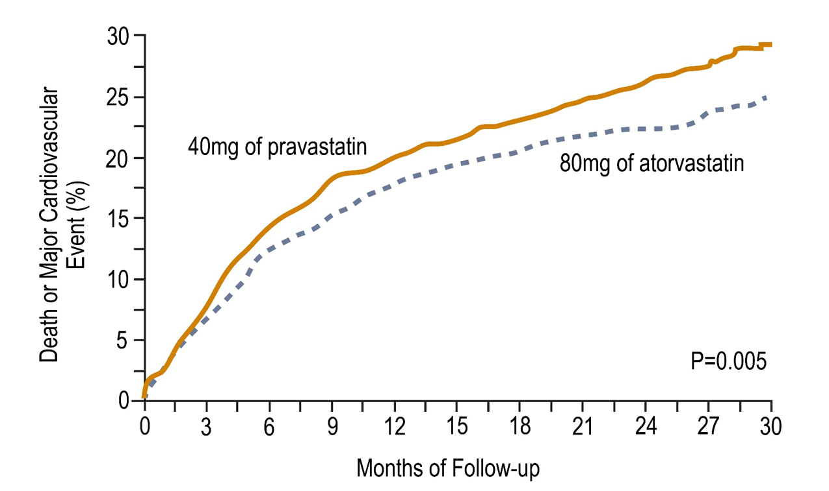
PROVE-IT TRIAL: Lessons from Statin Trials
High intensity statin therapy provides greater protection against CV events than moderate intensity statin therapy.
No. at Risk
Pravastatin | 2063 | 1688 | 1536 | 1423 | 810 | 138
Atorvastatin | 2099 | 1736 | 1591 | 1485 | 842 | 133
Baigent C, et al. Lancet. 2005; 366:1267-1278;
Cannon CP et al. N Engl J Med. 2004; 350:1495-1504

Slide 17
What Proportion of Patients Achieve LDL-C Target < 2 mmol/L on Statin Therapy?
50% or less
60%
70%
Over 80%

Slide 18
Many High-Risk Canadian Patients Treated with Statins Are Not at LDL-C Goal
DYSIS¹
Canadian high-risk patients are NOT at LDL-C target^{1*} (< 2.0 mmo/L)
88% of patients received a ‘potent’ statin with suboptimal dose
14% of patients received additional lipid-lowering agent
45%
DM-SCAN²
Canadian patients with diabetes are NOT at LDL-C target† (≤ 2.0 mmo/L)
82% of patients were on a lipid-lowering agent
43%
*High risk = coronary artery disease, peripheral arterial disease, cerebrovascular disease, diabetes mellitus or Framingham 10-year risk score ≥20%.
DYSIS Study – 2,436 patients, 1913 high risk patients.
†N = 5,069
1. Goodman SG et al. on behalf of the DYSIS Canadian Investigators. Can J Cardiol. 2010;26:e330-e335. 2. Leiter LA et al. on behalf of the DM-SCAN investigators. Can J Diabetes. 2013;37:82-89.

Slide 19
Treatment and LDL-C Management in Patients Diagnosed with Clinical Atherosclerotic Cardiovascular Disease in Alberta
LDL-C levels for patients on any lipid-lowing therapy who had both index and follow-up tests (n = 91,841).
Among patients on statin/non-statin therapy, n=91,841 had an index & follow-up LDL-C test.
Mean time to second test:
276 ± 217 days
48.5% of these patients were not achieving LDL-C <2.0 mmol/L at the index test (left);
36.6% were not achieving LDL-C <2.0 mmol/L or 50% reduction at follow-up (right).
µ = 2.2 ± 1.0 mmol/L
µ = 1.9 ± 0.8 mmol/L
Chen et al. Can J Cardiol. 2019. 35:884-891.

Slide 20


Treatment and LDL-C Management in Patients Diagnosed with Clinical Atherosclerotic Cardiovascular Disease in Alberta
60.2%
(n=87,048)
60.2% of patients on statin/non-statin therapy (n=144,607) were adherent (PDC≥0.8).
PDC, proportion of days covered
Chen et al. Can J Cardiol. 2019. 35:884-891.

Slide 21
Limitations of Current Therapies

Slide 22
If The Statin Dose Is Doubled, LDL-C Will Be Reduced By An Additional?
6%
10%
12%
15%
Depending on the statin

Slide 23
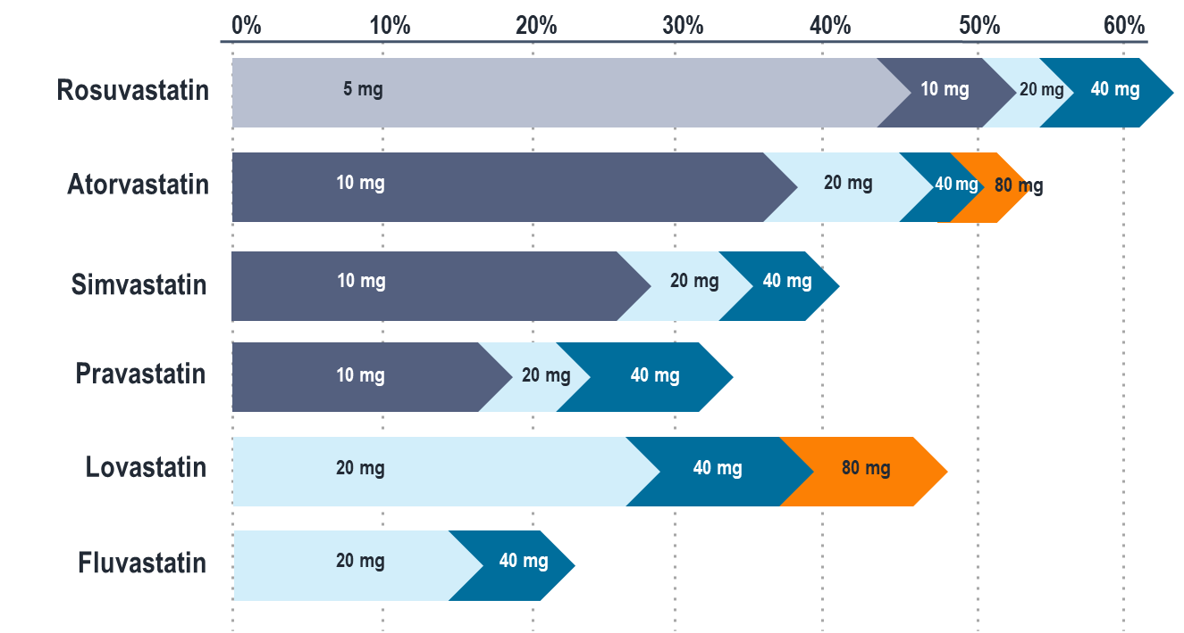

Even Maximal Statin Therapy May Not Be Sufficient In Achieving LDL-C Target
Doubling the statin dose results in only 6% LDL-C reduction
*As per Canadian Product Monographs
Crestor (rosuvastatin) Product Monograph. AstraZeneca. April 21, 2015.
Lipitor (atorvastatin) Product Monograph. Pfizer. Feb 18, 2016.
Pravachol (pravastatin) Product Monograph Bristol-Myers Squibb Canada. Nov 30, 2015.
Mevacor (lovastatin) Product Monograph. Merck. Jul. 24, 2012.
Zocor (simvastatin) Product Monograph. Merck. Dec 10, 2014.
Lescol (fluvastatin) Product Monograph. Novartis. Aug. 26, 2016.
Adapted from CURVES Investigators. Am J Cardiol. 1998;81:582-587.

Slide 24
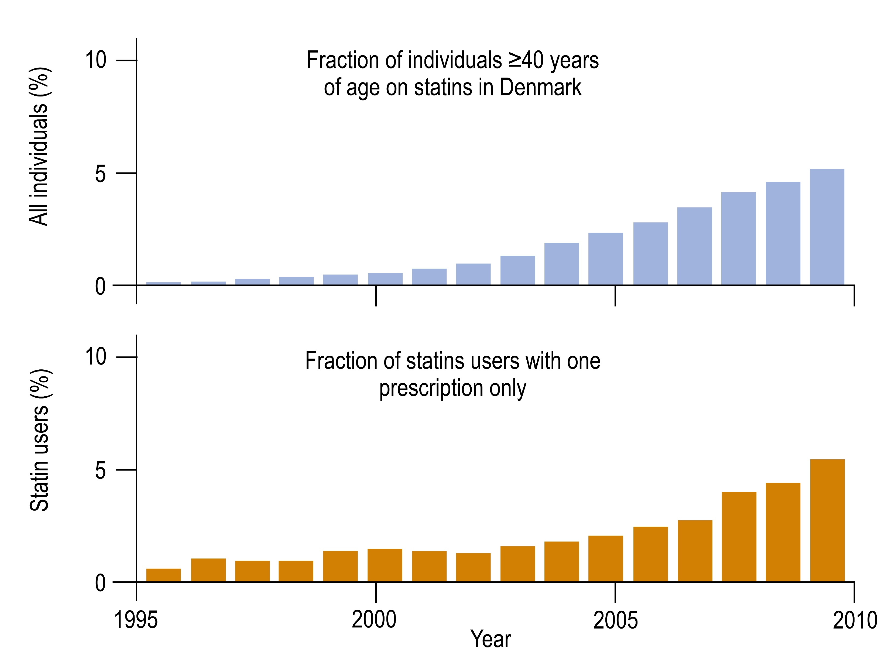
Statin Side Effects: An Evolving Problem
While statin prescription increased, non-adherence/
discontinuation of statin therapy was also more problematic
Stroes EL at al. Eur H J 2015; 36: 1012-22. Adapated from Dr. Sune F. Nielsen and Prof Borge G. Norderstagaard

Slide 25
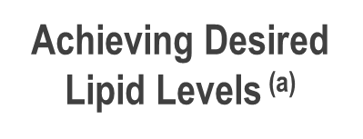
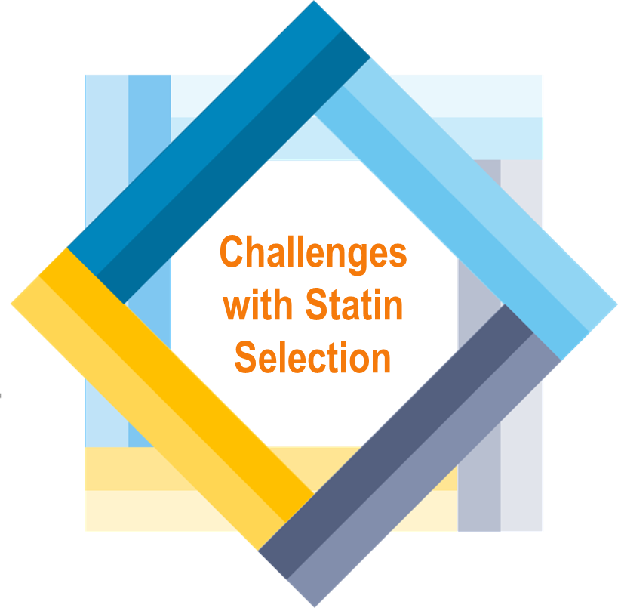
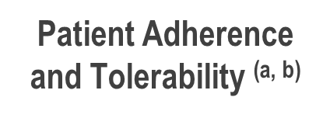
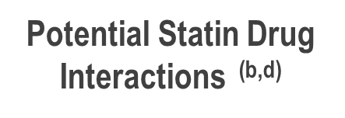
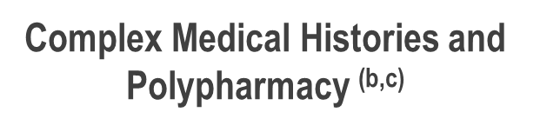
Multiple Challenges with Statin Selection
Ansell BJ. J Manag Care Pharm. 2008; 14 (suppl S-b): 29-S15;
Meade LT. US Pharm. 2007; 32:66-71;
Vogeli C, et al. J Gen Intern Med. 2007; 22(suppl 3): 391-395;
Ito M, et al. J Clin Lipidol. 2014;8:69-76

Slide 26
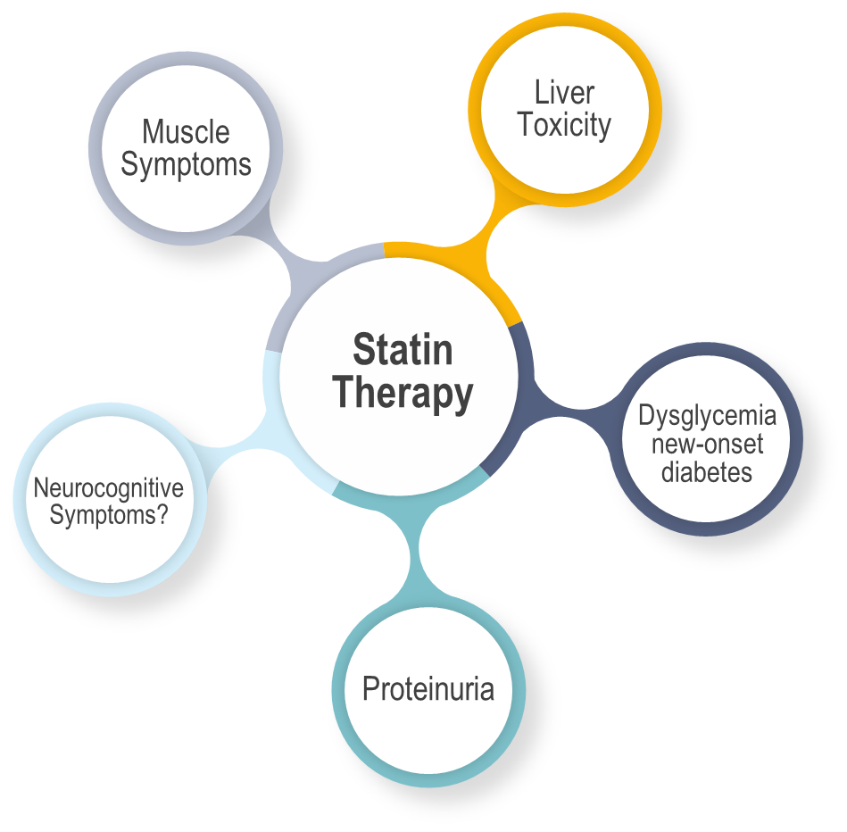
Adverse Effects Reported with Statin Therapy
Mach F, et al. Eur Heart J 2018; 39:2526-39

Slide 27
Impact of Statin-Associated Muscle Symptoms (SAMS)
Consequences of Low Statin Adherence: Increased CV Risk
Proportion of days covered with statin therapy (%) | Hazard ratio (95% CI) Primary Prevention | Hazard ratio (95% CI) Secondary Prevention
<10 | 1 (reference) | 1 (reference)
10-19 | 1.35 (1.22-1.50) | 1.28 (1.18-1.39)
50-59 | 0.77 (0.67-0.88) | 0.69 (0.63-0.76)
>90 | 0.55 (0.49-0.61) | 0.49 (0.46-0.53)
75% of patients discontinue statin within 2 years
SAMS is the prevailing reason in ~60% of patients
Chodick G et al. Clin Ther 2008;30:2167-79.
Cohen J et al. Clin Lipidol 2012;6:208-15
Shalev. Arch. Int Med 2009

Slide 28
In patients with statin associated side effects, what proportion occur within the first six months?
30%
65%
78%
90%

Slide 29
Overall statin intolerance occurs in what
proportion of treated patients?
< 10%
10-15%
15-20%
>20%

Slide 30
Statin-Associated Muscle Symptoms vs. Statin Intolerance
Muscle-Related Side Effects
Statin Intolerance
90% of all cases appear within the first 6 months after treatment initiation or dose up-titration
Muscle aches (myalgia), weakness, stiffness and cramps
Myopathy (myositis): accompanied with CK 10 x ULN
Patients with normal CK may also have symptoms of myopathy with statin therapy
Rhabdomyolysis: CK >50 x ULN, myoglobinemia, myoglobinuria-induced acute renal failure; resulting in skeletal muscle injury; 10% risk of death*
Occurs in 10% to 15% of patients
Defined by NLA* as the inability to tolerate at least 2 statins (one at lowest daily dose and one at any daily dose) due to symptoms or abnormal labs – temporarily related to statin treatment
Complete intolerance – intolerant to any statin at any dose
Partial intolerance – intolerant to some statins and some doses
Could result from: Muscle symptoms, headache, sleep disorders, dyspepsia, nausea, rash, alopecia, erectile dysfunction, gynecomastia, and/or arthritis
* NLA –National Lipid Association
* Death from hyperkalemia-induced arrhythmia or disseminated intravascular coagulation
Banach M, et al. Arch Med Sci. 2015;11:1-23

Slide 31
Large Individual Variability in LDL-C Reduction with Atorvastatin 10 mg
Men
Women
0
0
-10
-10
-20
-20
-30
-30
Percent LDL-C change
Percent LDL-C change
-40
-40
-50
-50
-60
-60
-70
-70
Patients with familial hypercholesterolemia
Pedro-Botet J, et al. Atherosclerosis 2001; 158(1):183-93.
Notes:
Notes:
In this study of patients with familial hypercholesterolemia, there is a very large variability in the reduction of LDL-C to atorvastatin 10 mg.
Reference:
Pedro-Botet J, Schaefer EJ, Bakker-Arkema RG, et al. Apolipoprotein E genotype affects plasma lipid response to atorvastatin in a gender specific manner. Atherosclerosis 2001; 158(1):183-93.

Slide 32
Non-Statin Strategies to Reduce LDL-C

Slide 33
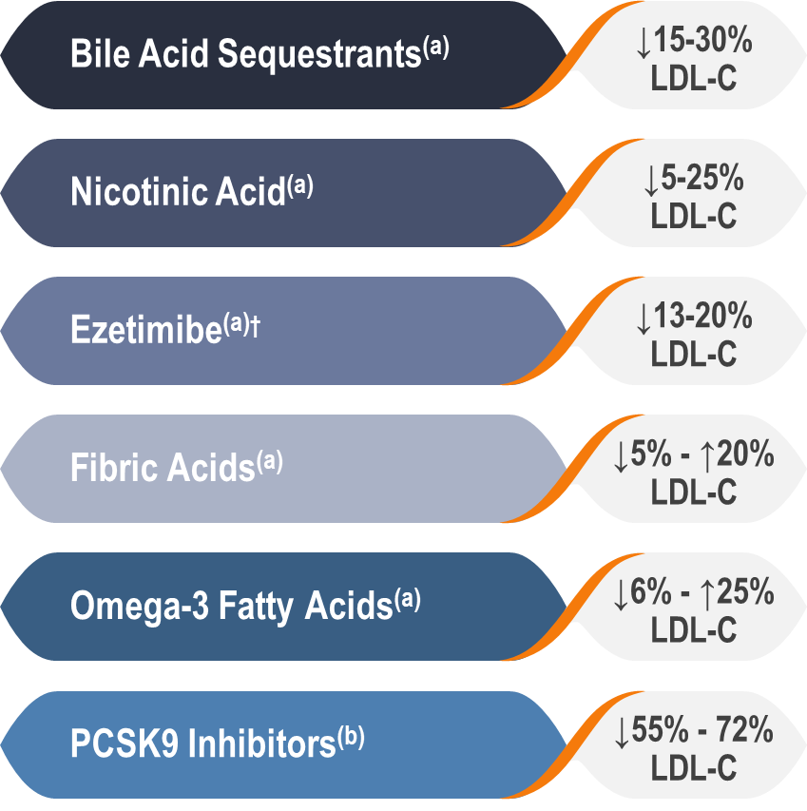
Non-Statin Therapy for Adjunct LDL-Lowering
Non-Statin Therapy Effect on LDL-C*
Increasing trend in non-statin use among adults with atherosclerotic CVD^{(c)}
1 in 7 adults use non-statin therapy, including high-intensity statin users
Prescriptions for non-statin therapy doubled from 7.5% in 2002 to 13.9% in 2013
Primarily used as an adjunct LDL-lowering therapy in combination with statins^{(c)}
Not used as much in patients with statin intolerance
* Effects on other lipoproteins not listed for brevity. † Cholesterol Absorption Inhibitor
Jacobson TA, et al. J Clin Lipidol 2014;8:473-488;
Rosenson RS, et al. J Am Coll Cardiol.2018;72:314-329
Salami JA, et al. J Am Heart Assoc. 2018;7:e007132

Slide 34

2016 CCS Lipid Guidelines Recommend:
Beyond Statin Drugs for ASCVD Prevention
We recommend ezetimibe as second-line therapy to lower LDL-C in patients with clinical cardiovascular disease if targets are not reached on maximally tolerated statin therapy. (Strong Recommendation, High Quality evidence)
We recommend that niacin not be added to statin therapy for CVD prevention in patients who have achieved LDL-C targets. (Strong Recommendation, High Quality Evidence)
We do not recommend the addition of fibrates to statin therapy for CVD event prevention in patients who have achieved LDL-C targets. (Strong recommendation, High Quality evidence). Values and preferences: In sub-group analysis, patients with elevated triglycerides and low HDL-C may benefit from fibrate therapy.
TREATMENT TARGETS:
Anderson et al. 2016 Canadian Cardiovascular Society Guidelines for the Management of Dyslipidemia for the Prevention of Cardiovascular Disease in the Adult Canadian Journal of Cardiology 2016;32:1263-1282
Notes:
Speaker Notes:
In the first year of the trial, Koren and colleagues randomly assigned patients in a 2:1 ratio to open-label treatment with evolocumab 420 mg per month plus standard-of-care treatment compared with standard-of-care treatment only. More patients (n = 882) were enrolled in the evolocumab arm compared with the standard-of-care treatment arm (n = 442). After the first year, all patients received extended, monthly evolocumab therapy plus standard-of-care treatment. The researchers examined the impact of evolocumab on lipids and safety outcomes, including antidrug antibodies, over the 5-year study period.
Treatment with evolocumab decreased median LDL cholesterol by 61% in year 1, 59% in year 2, 59% in year 3, 59% in year 4 and 58% in year 5. The analysis included 818 patients in year 1, 1,122 patients in year 2, 1,059 patients in year 3, 1,012 patients in year 4 and 870 patients in year 5.
Adverse events occurred in 79% of patients in year 1, 74% of patients in year 2, 71% of patients in year 3, 67% of patients in year 4 and 65% of patients in year 5. Serious adverse events occurred in 7%, 7%, 8%, 7% and 7%, respectively, of patients over the same time period. Adverse events that resulted in drug discontinuation occurred in 2.8%, .8%, 1.3%, 1% and .2% of patients each year from years 1 to 5.
Transiently positive tests for binding antidrug antibodies during year 1 were seen in two patients in the standard-of-care arm and two patients in the evolocumab arm. There were no subsequent or novel reports of binding or neutralizing antidrug antibodies noted after that point, according to Koren and colleagues.
“In OSLER-1, the longest study of a PCSK9 inhibitor to date, evolocumab consistently reduced LDL cholesterol with no increase in adverse events over time and no neutralizing antibodies,

Slide 35
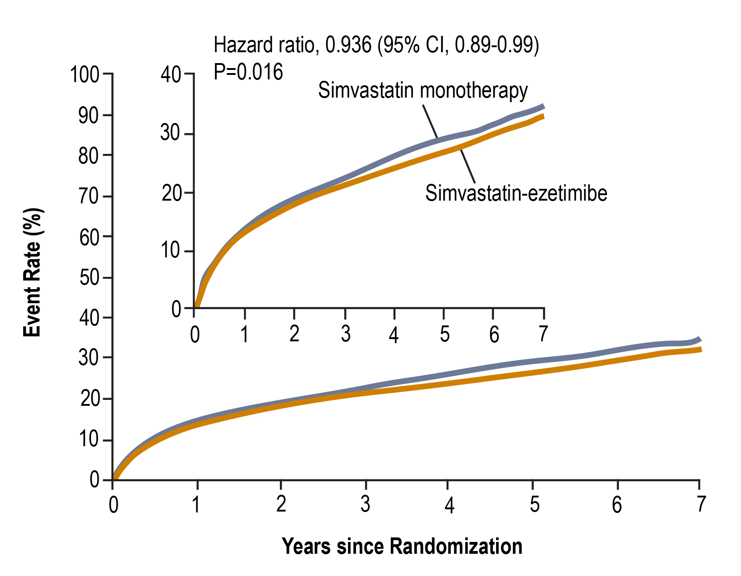
IMPROVE-IT Study
Non-Statin Strategies to Further Reduce LDL-C
Ezetimibe
Adding ezetimibe to statin therapy:
Additional LDL-C reduction of about 20%
6% reduction in CV events
Could we achieve event more benefit with even greater lowering of LDL-C?
Cannon CP, et al. N Engl J Med. 2015;372:2387-2397

Slide 36
2016 CCS Lipid Guidelines Recommend:
Recommendations for PCSK9i in FH and ASCVD
We suggest the use of PCSK9 inhibitors (evolocumab, alirocumab) to lower LDL-C for patients with heterozygous familial hypercholesterolemia whose LDL-C remains above target despite maximally tolerated statin therapy (Conditional recommendation, moderate quality evidence)
We suggest that PCSK9 inhibitors be considered to lower LDL-C for patients with atherosclerotic cardiovascular disease in those not at LDL-C goal despite maximally tolerated statin +/- ezetimibe therapy (Conditional recommendation, moderate quality evidence)
We suggest that evolocumab be added to background therapy in patients with homozygous familial hypercholesterolemia and continued if LDL-C lowering is documented (Conditional recommendation, moderate quality evidence)
TREATMENT TARGETS:
Anderson et al. 2016 Canadian Cardiovascular Society Guidelines for the Management of Dyslipidemia for the Prevention of Cardiovascular Disease in the Adult Canadian Journal of Cardiology 2016;32:1263-1282
Notes:
Speaker Notes:
In the first year of the trial, Koren and colleagues randomly assigned patients in a 2:1 ratio to open-label treatment with evolocumab 420 mg per month plus standard-of-care treatment compared with standard-of-care treatment only. More patients (n = 882) were enrolled in the evolocumab arm compared with the standard-of-care treatment arm (n = 442). After the first year, all patients received extended, monthly evolocumab therapy plus standard-of-care treatment. The researchers examined the impact of evolocumab on lipids and safety outcomes, including antidrug antibodies, over the 5-year study period.
Treatment with evolocumab decreased median LDL cholesterol by 61% in year 1, 59% in year 2, 59% in year 3, 59% in year 4 and 58% in year 5. The analysis included 818 patients in year 1, 1,122 patients in year 2, 1,059 patients in year 3, 1,012 patients in year 4 and 870 patients in year 5.
Adverse events occurred in 79% of patients in year 1, 74% of patients in year 2, 71% of patients in year 3, 67% of patients in year 4 and 65% of patients in year 5. Serious adverse events occurred in 7%, 7%, 8%, 7% and 7%, respectively, of patients over the same time period. Adverse events that resulted in drug discontinuation occurred in 2.8%, .8%, 1.3%, 1% and .2% of patients each year from years 1 to 5.
Transiently positive tests for binding antidrug antibodies during year 1 were seen in two patients in the standard-of-care arm and two patients in the evolocumab arm. There were no subsequent or novel reports of binding or neutralizing antidrug antibodies noted after that point, according to Koren and colleagues.
“In OSLER-1, the longest study of a PCSK9 inhibitor to date, evolocumab consistently reduced LDL cholesterol with no increase in adverse events over time and no neutralizing antibodies,

Slide 37
Adding a PCSK9 Inhibitor to statin therapy further reduces LDL-C by?
35-45%
50-60%
65%
70%

Slide 38




Non-Statin Strategies to Further Reduce LDL-C
PCSK9 Inhibitors
PCSK9 inhibitors further reduce LDL-C by an average of 50 to 60%
Adding ezetimibe to statin therapy:
Additional LDL-C reduction of about 20%
6% reduction in CV events
Further reduce the risk of CV events
CV benefits are proportional to the absolute reduction in LDL-C and the duration of treatment
Greatest benefit reported in patients with additional high-risk factors such as recent MI, polyvascular disease, prior CV events
The real challenge now is to identify which patients would benefit most from PCSK9 inhibitors
?
?
?
?
Sebatine MS, N Engl J Med. 2017;376:1713-1722;
Schwartz GG, et al. N Engl J Med. 2018;379:2097-2107

Slide 39
PCSK9 Inhibitors: News and Pearls

Slide 40

Are PCSK9 Inhibitors Efficient at Lowering LDL-C?

Slide 41
Can LDL-C Lowering be Achieved Safely and Effectively with PCSK9 Inhibitors?
Only if ezetimibe is used as well
Only if ezetimibe is not used
Only if maximal statin therapy is not used
Only in statin intolerant patients
None of the above

Slide 42
Additional LDL-C Reduction Observed With The Addition Of A PCSK9 Inhibitor
Alirocumab 75 mg
Q2W
Alirocumab 75/150 mg
Q2W
Alirocumab 150 mg
Q2W
Evolocumab 140 mg
Q2W
Evolocumab
420 mg
QM
Heterozygous Familial Hypercholesterolemia
Clinical ASCVD
Alirocumab Canadian Product Monograph, September 20, 2018;
Evolocumab Canadian Product Monograph, June 11, 2019

Slide 43
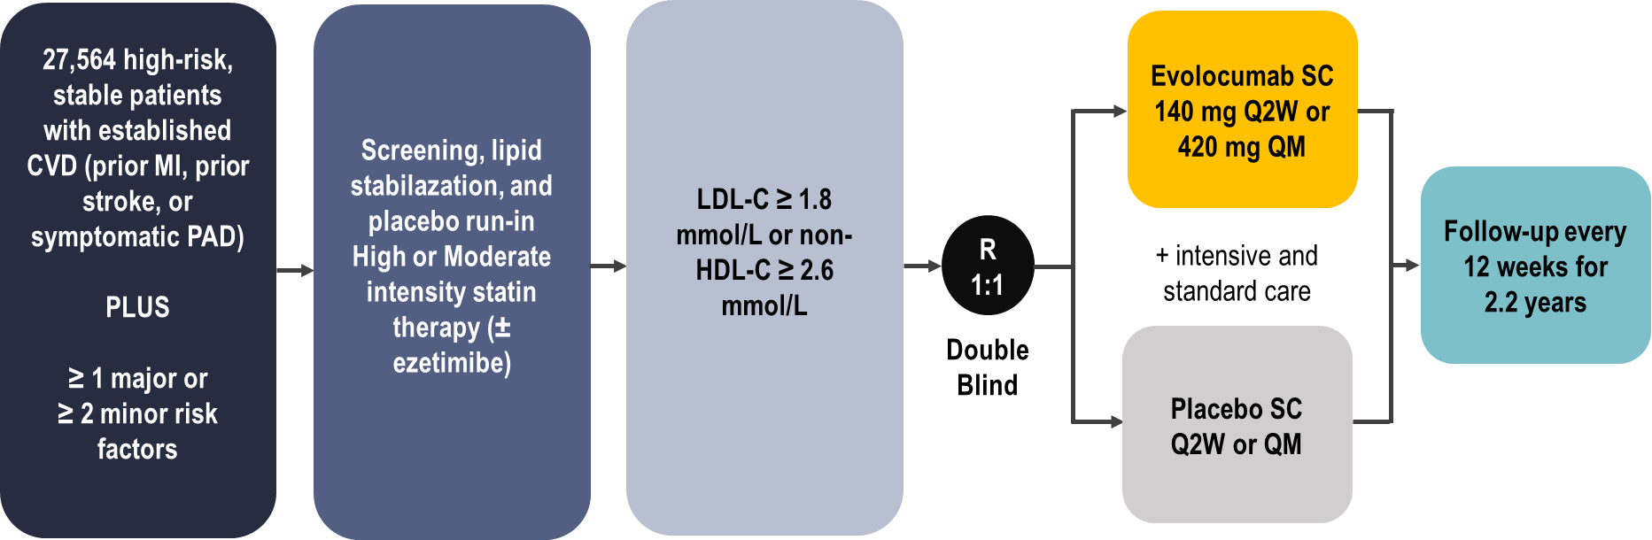
FOURIER Outcomes Trial
Evolocumab
Primary Efficacy Endpoint: composite of CV death, MI, stroke, hospitalization for UA, or coronary revascularization
Secondary Efficacy Endpoint: composite of CV death, MI, stroke
Sebatine MS, et al. N Engl J Med. 2017;376:1713-1722

Slide 44
ODYSSEY Outcomes Study
Alirocumab
18,924 patients with ACS within prior year, not stable ASCVD
2 to 16 weeks optimized atorvastatin/rosuvastatin
If LDL-C ≥ 1.8 mmol/L, non-HDL-C ≥ 2.6 mmol/L, or apoB ≥ 0.8 g/L patients were randomized to:
Alirocumab 75 mg every two weeks or placebo
Titration target: 0.6 to 1.3 mmol/L
If LDL-C ≥ 1.3 mmol/L → alirocumab uptitrated to 150 mg every 2 weeks
If LDL-C < 0.4 mmol/L → switched to placebo
Median follow-up 2.8 years
On-treatment LDL-C: alirocumab 1.4 mmol/L vs. placebo 2.6 mmol/L
Schwartz GG, et al. N Engl J Med. 2018:379:2097-2107

Slide 45
PCSK9 Inhibitors are Efficient at Lowering LDL-C
Sebatine MS, et al. N Engl J Med. 2017;376:1713-1722
Schwartz GG, et al. N Engl J Med. 2018:379:2097-2107

Slide 46

Guideline Oriented Approach to
Lipid lowering in Canada (GOAL)
The GOAL Program is an ongoing real-world designed and coordinated by the Canadian Heart Research Centre
The GOAL Program is evaluating the management of patients at high-risk, defined as those with clinical atherosclerotic cardiovascular disease, and an LDL-C >2.0 mmol/L despite maximal tolerated statin therapy
The program incorporates a mechanism to support decision making and choice of therapy in order to assist physicians in achieving the Canadian Cardiovascular Society guideline-recommended LDL-C targets in high risk patients.
The interactive program has 3 distinct components:
Capture of data as reported by the physician based on LDL-C lowering strategies at each visit.
Feedback on potential opportunities for LDL-C lowering based on CCS guidelines.
Identification of challenges and reasons faced by physicians (continuation of the care gap).

Slide 47
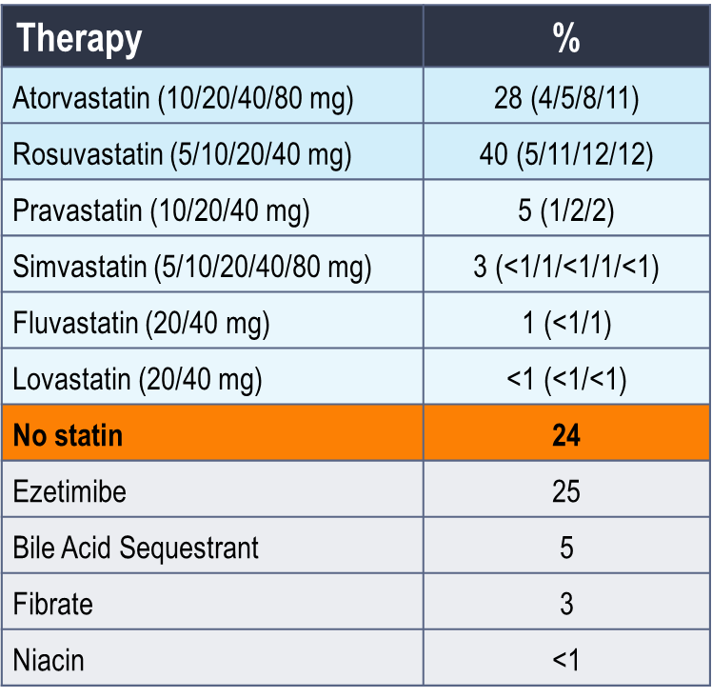
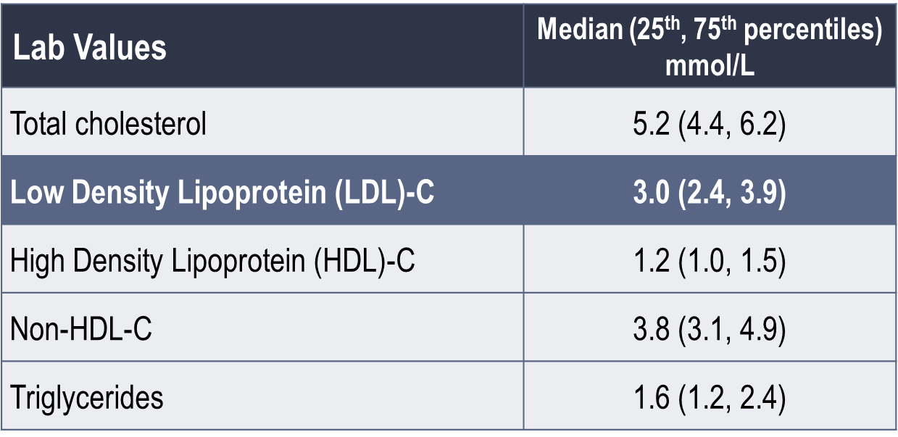
Real World Data
GOAL: Baseline Lipid Profile and Management
N = 2,024
April 4, 2019 - data cut CHRC file

Slide 48
Real World Data
GOAL: Additional Lipid Modifying Therapy
% of Patients
⁺ ≥6 weeks post Visit 2
April 4, 2019 - data cut CHRC file

Slide 49
Real World Data
GOAL - % of Patients Achieving LDL-C Target*
% of Patients
* ≤2.0 mmol/L by Canadian Cardiovascular Society Guideline Recommendations
April 4, 2019 - data cut CHRC file

Slide 50
Real World Data:
Treatment and LDL-C Management in Patients Diagnosed with Clinical Atherosclerotic Cardiovascular Disease in Alberta
LDL-C levels pre-and-post PCSK9 inhibitor treatment
LDL-C level (mmol/L)
Among 82 patients who received PCSK9 inhibitors, n = 41 had pre- and post-treatment LDL-C tests
Mean (SD) days between tests:
48.5 ± 45.5 days
In these patients, mean LDL-C decreased from 2.5 ± 1.3 mmol/L to 1.3 ± 1.2 mmol/L
2.5 ± 1.3
1.3 ± 1.2
Supplementary Figure S1. Mean (±SD) LDL-C levels pre- and post- PSCK9 inhibitor treatment
Chen et al. Can J Cardiol. 2019. 35:884-891.

Slide 51
Do PCSK9 Inhibitors Reduce CV Events?

Slide 52
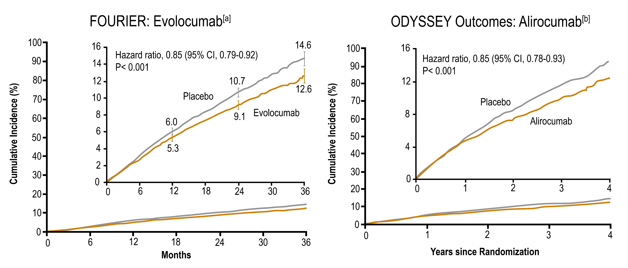
PCSK9 Inhibitors Reduce CV Events
MACE: CV death, MI, stroke, hospitalization for UA, or coronary revascularization
MACE: CHD death, nonfatal MI, ischemic stroke, or UA requiring hospitalization
Sebatine MS, et al. N Engl J Med. 2017;376:1713-1722
Schwartz GG, et al. N Engl J Med. 2018:379:2097-2107

Slide 53
Are PCSK9 Inhibitors Safe?

Slide 54
With Respect to Safety of PCSK9 Inhibitors, Which is True?
There is concern about neuro-cognitive AE
There is concern about myalgia
No significant adverse events have been demonstrated
The use of vitamin D supplementation is recommended

Slide 55
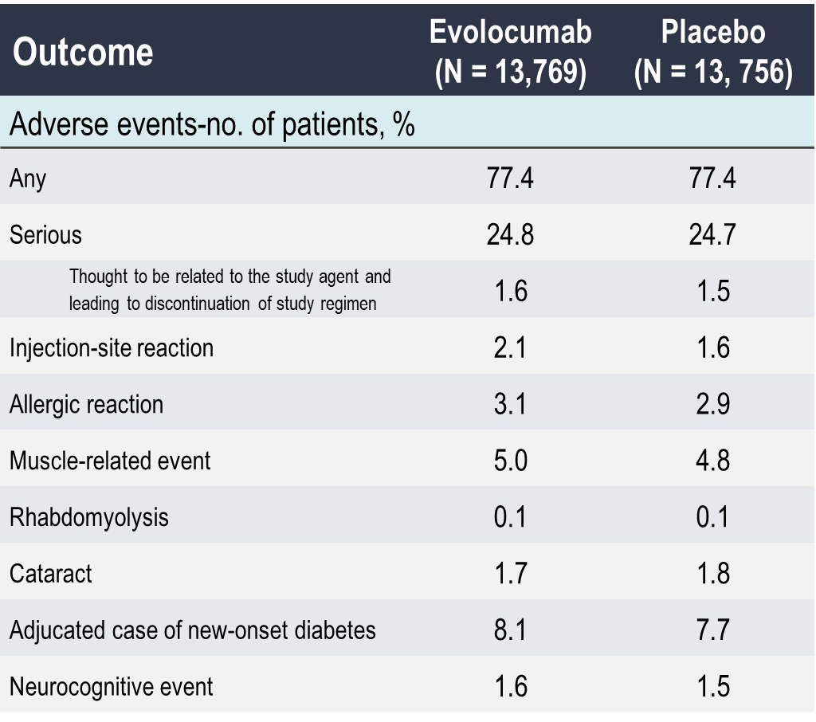
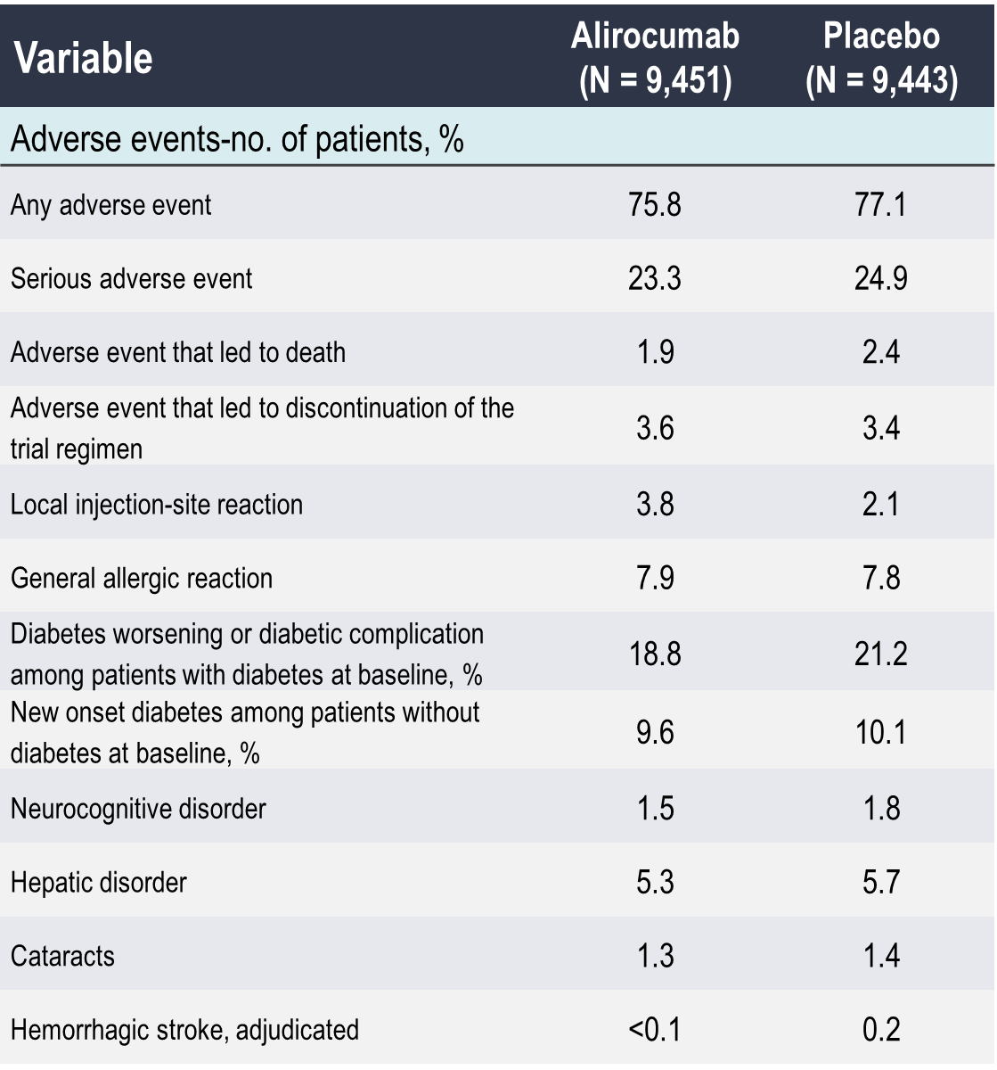
PCSK9 Inhibitors are Safe
FOURIER: Evolocumab^{(a)}
ODYSSEY Outcomes: Alirocumab^{(b)}
Sebatine MS, et al. N Engl J Med. 2017;376:1713-1722
Schwartz GG, et al. N Engl J Med. 2018:379:2097-2107
Notes:
PCSK9 inhibitors side effects comparable to placebo

Slide 56
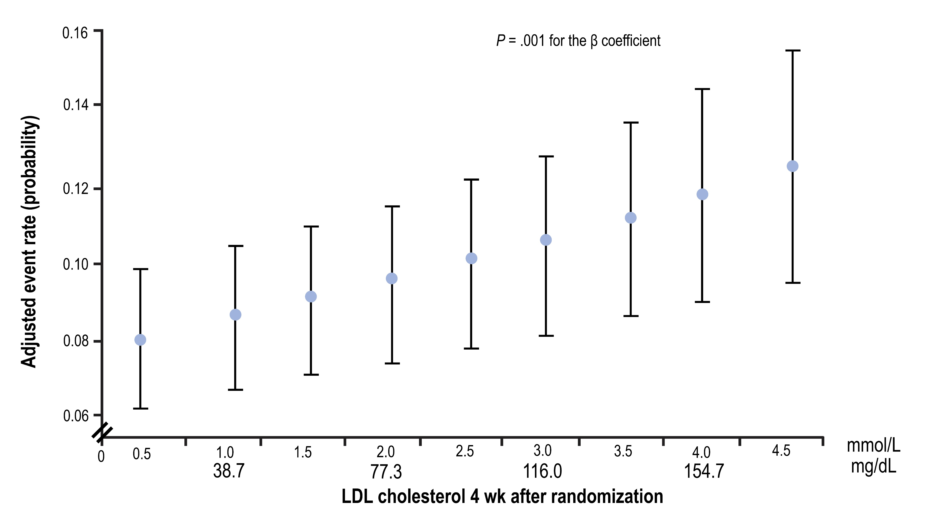
FOURIER: PCSK9 Inhibitors Reported a Clinical Benefit Associated with Very Low LDL-C Levels
Giugliano RP, et al. Lancet. 2017;390:1962-1971

Slide 57
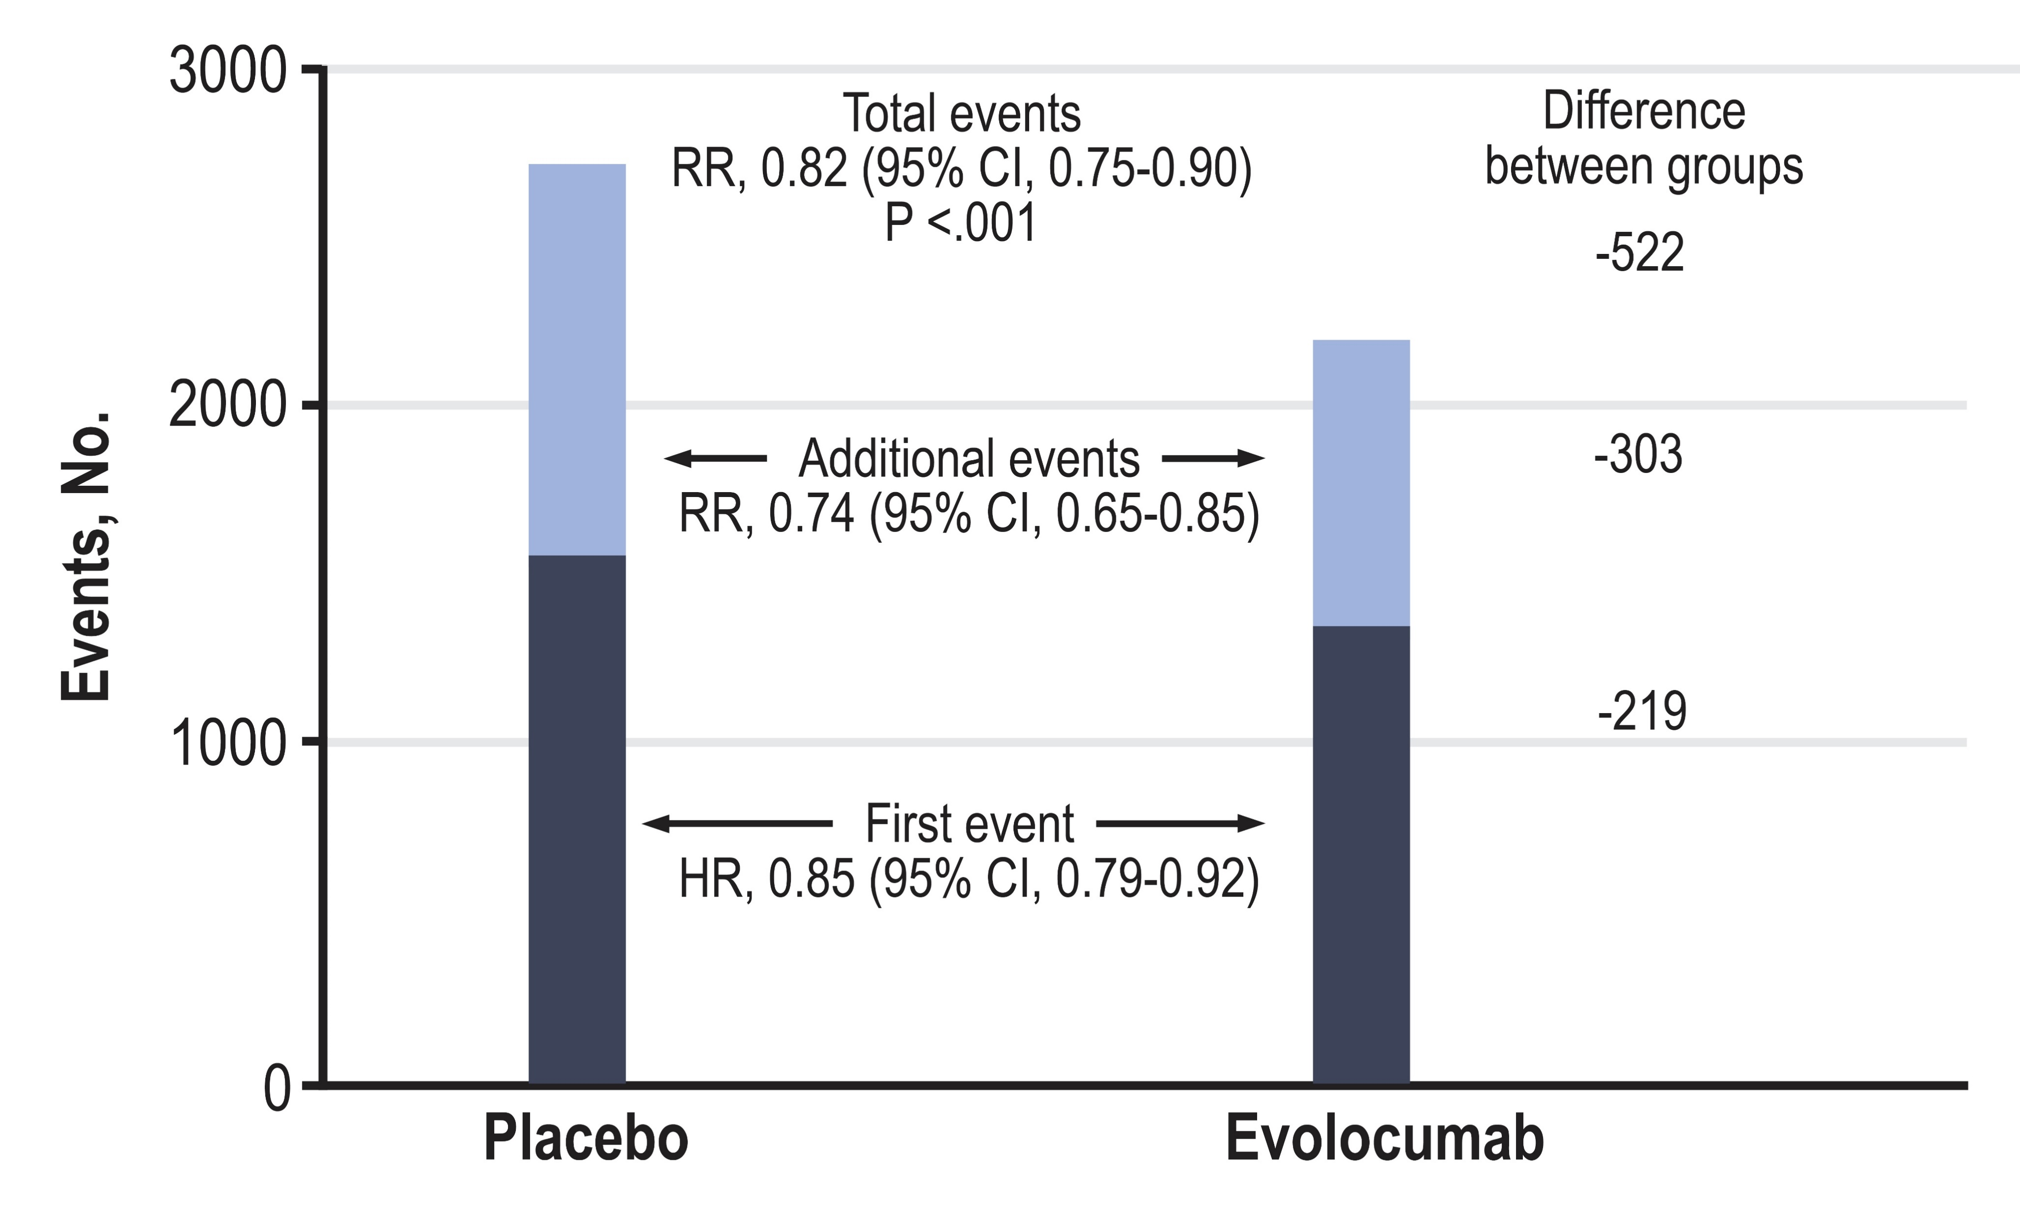
A Prespecified Analysis From the FOURIER Trial
First, Additional, and Total Primary End Point Events
During Follow-up by Randomization Group
Murphy SA, et al. JAMA Cardiol. 2019;4(7):613-619.
Notes:
Speaker Notes:
The first occurrence of the primary end point was significantly reduced in the
evolocumab group compared with the placebo group (hazard ratio [HR], 0.85;
95%CI, 0.79-0.92; P < .001), as were additional events (incidence rate ratio
[RR], 0.74; 95%CI, 0.65-0.85) and total events (RR, 0.82; 95%CI, 0.75-0.90;
P < .001).

Slide 58
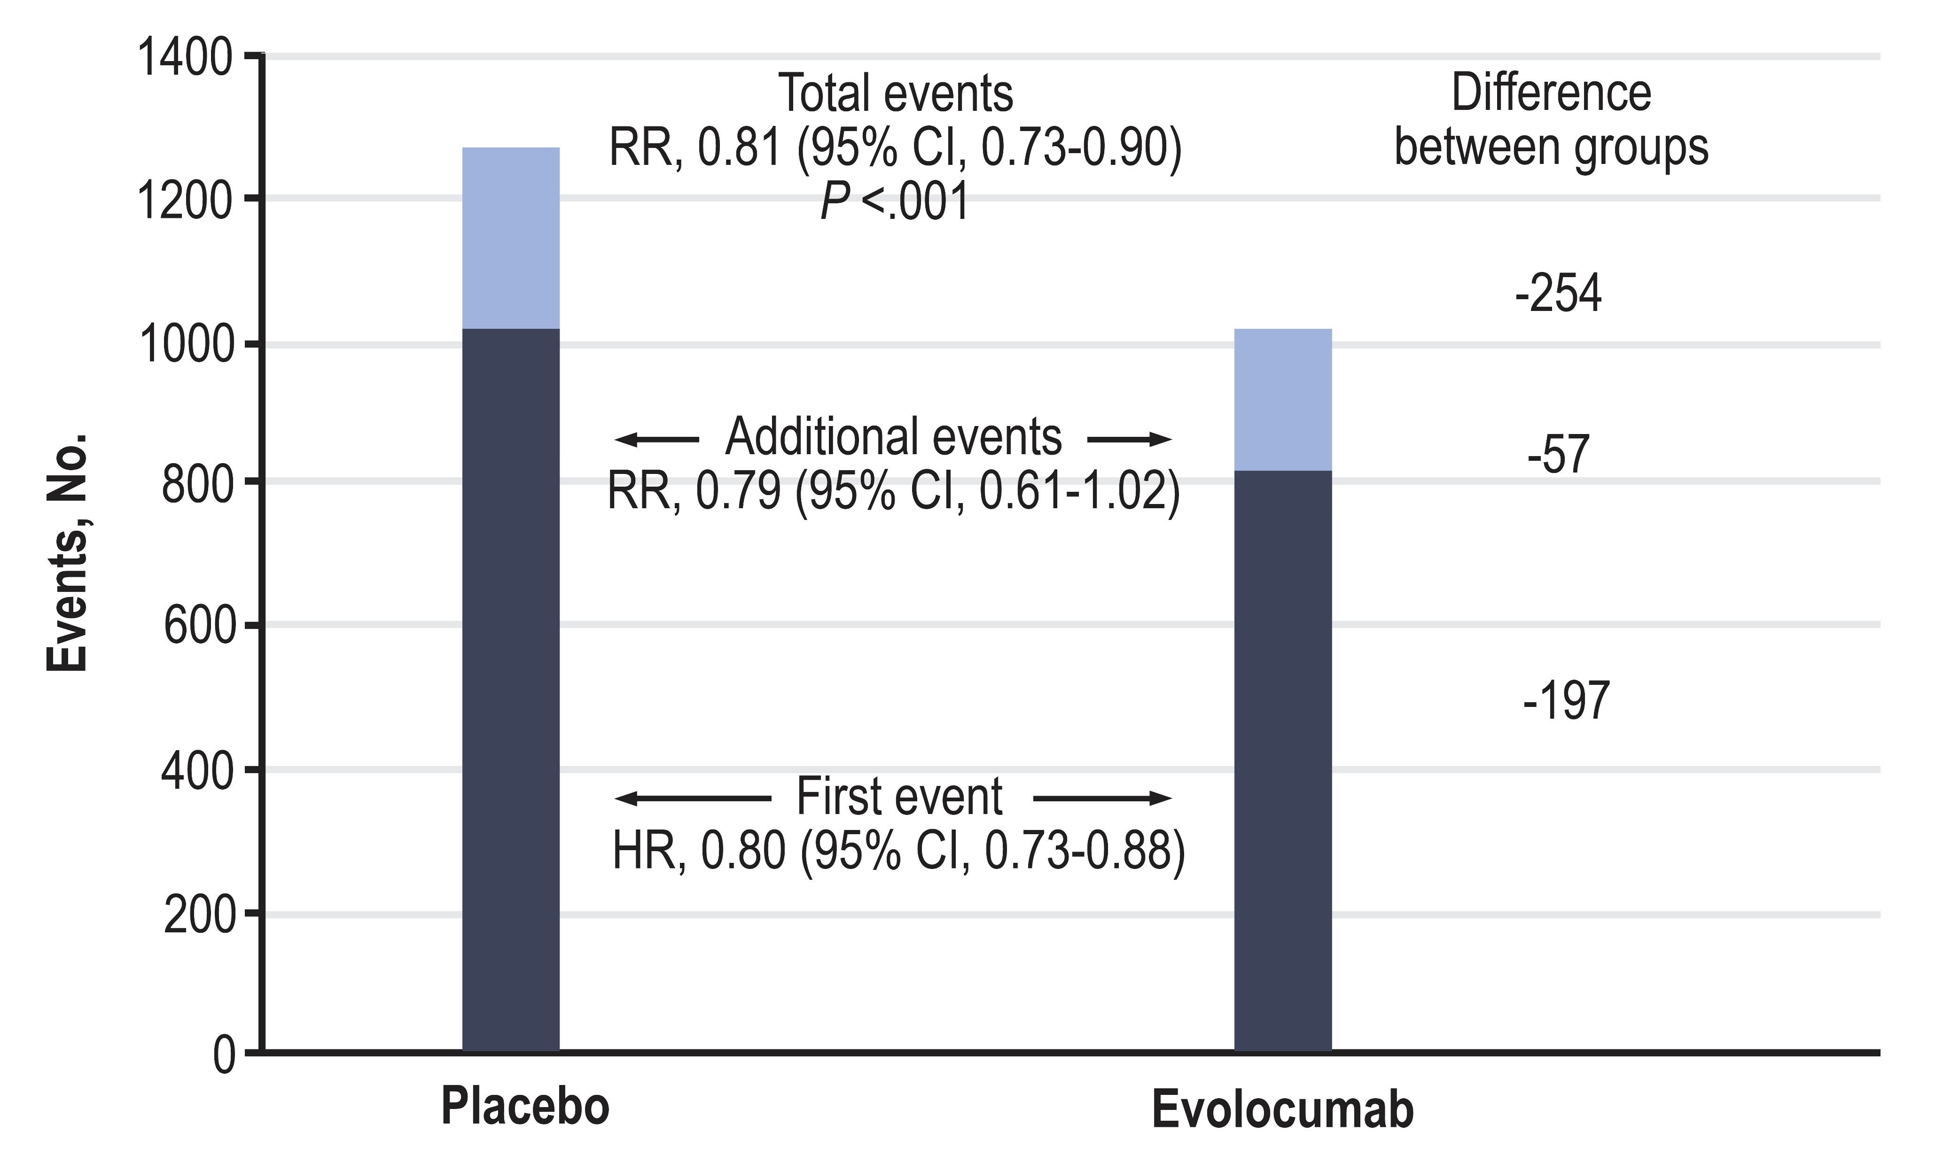
A Prespecified Analysis From the FOURIER Trial
Total Events During Follow-up by Randomization Group for Key Secondary End Point of Cardiovascular Death, Myocardial Infarction, or Stroke
Murphy SA, et al. JAMA Cardiol. 2019;4(7):613-619.
Notes:
Speaker Notes:
Total events were reduced with evolocumab (incidence rate ratio [RR], 0.81;
95%CI, 0.73-0.90; P < .001). HR indicates hazard ratio.

Slide 59
FOURIER Trial
Total Primary Endpoint Events
Number of Events Prevented for 1000 Patients Treated with Evolocumab for 3 Years
Events per 1000 Patients
First Event Only
Total Events
Murphy SA, et al. AHA 2017

Slide 60
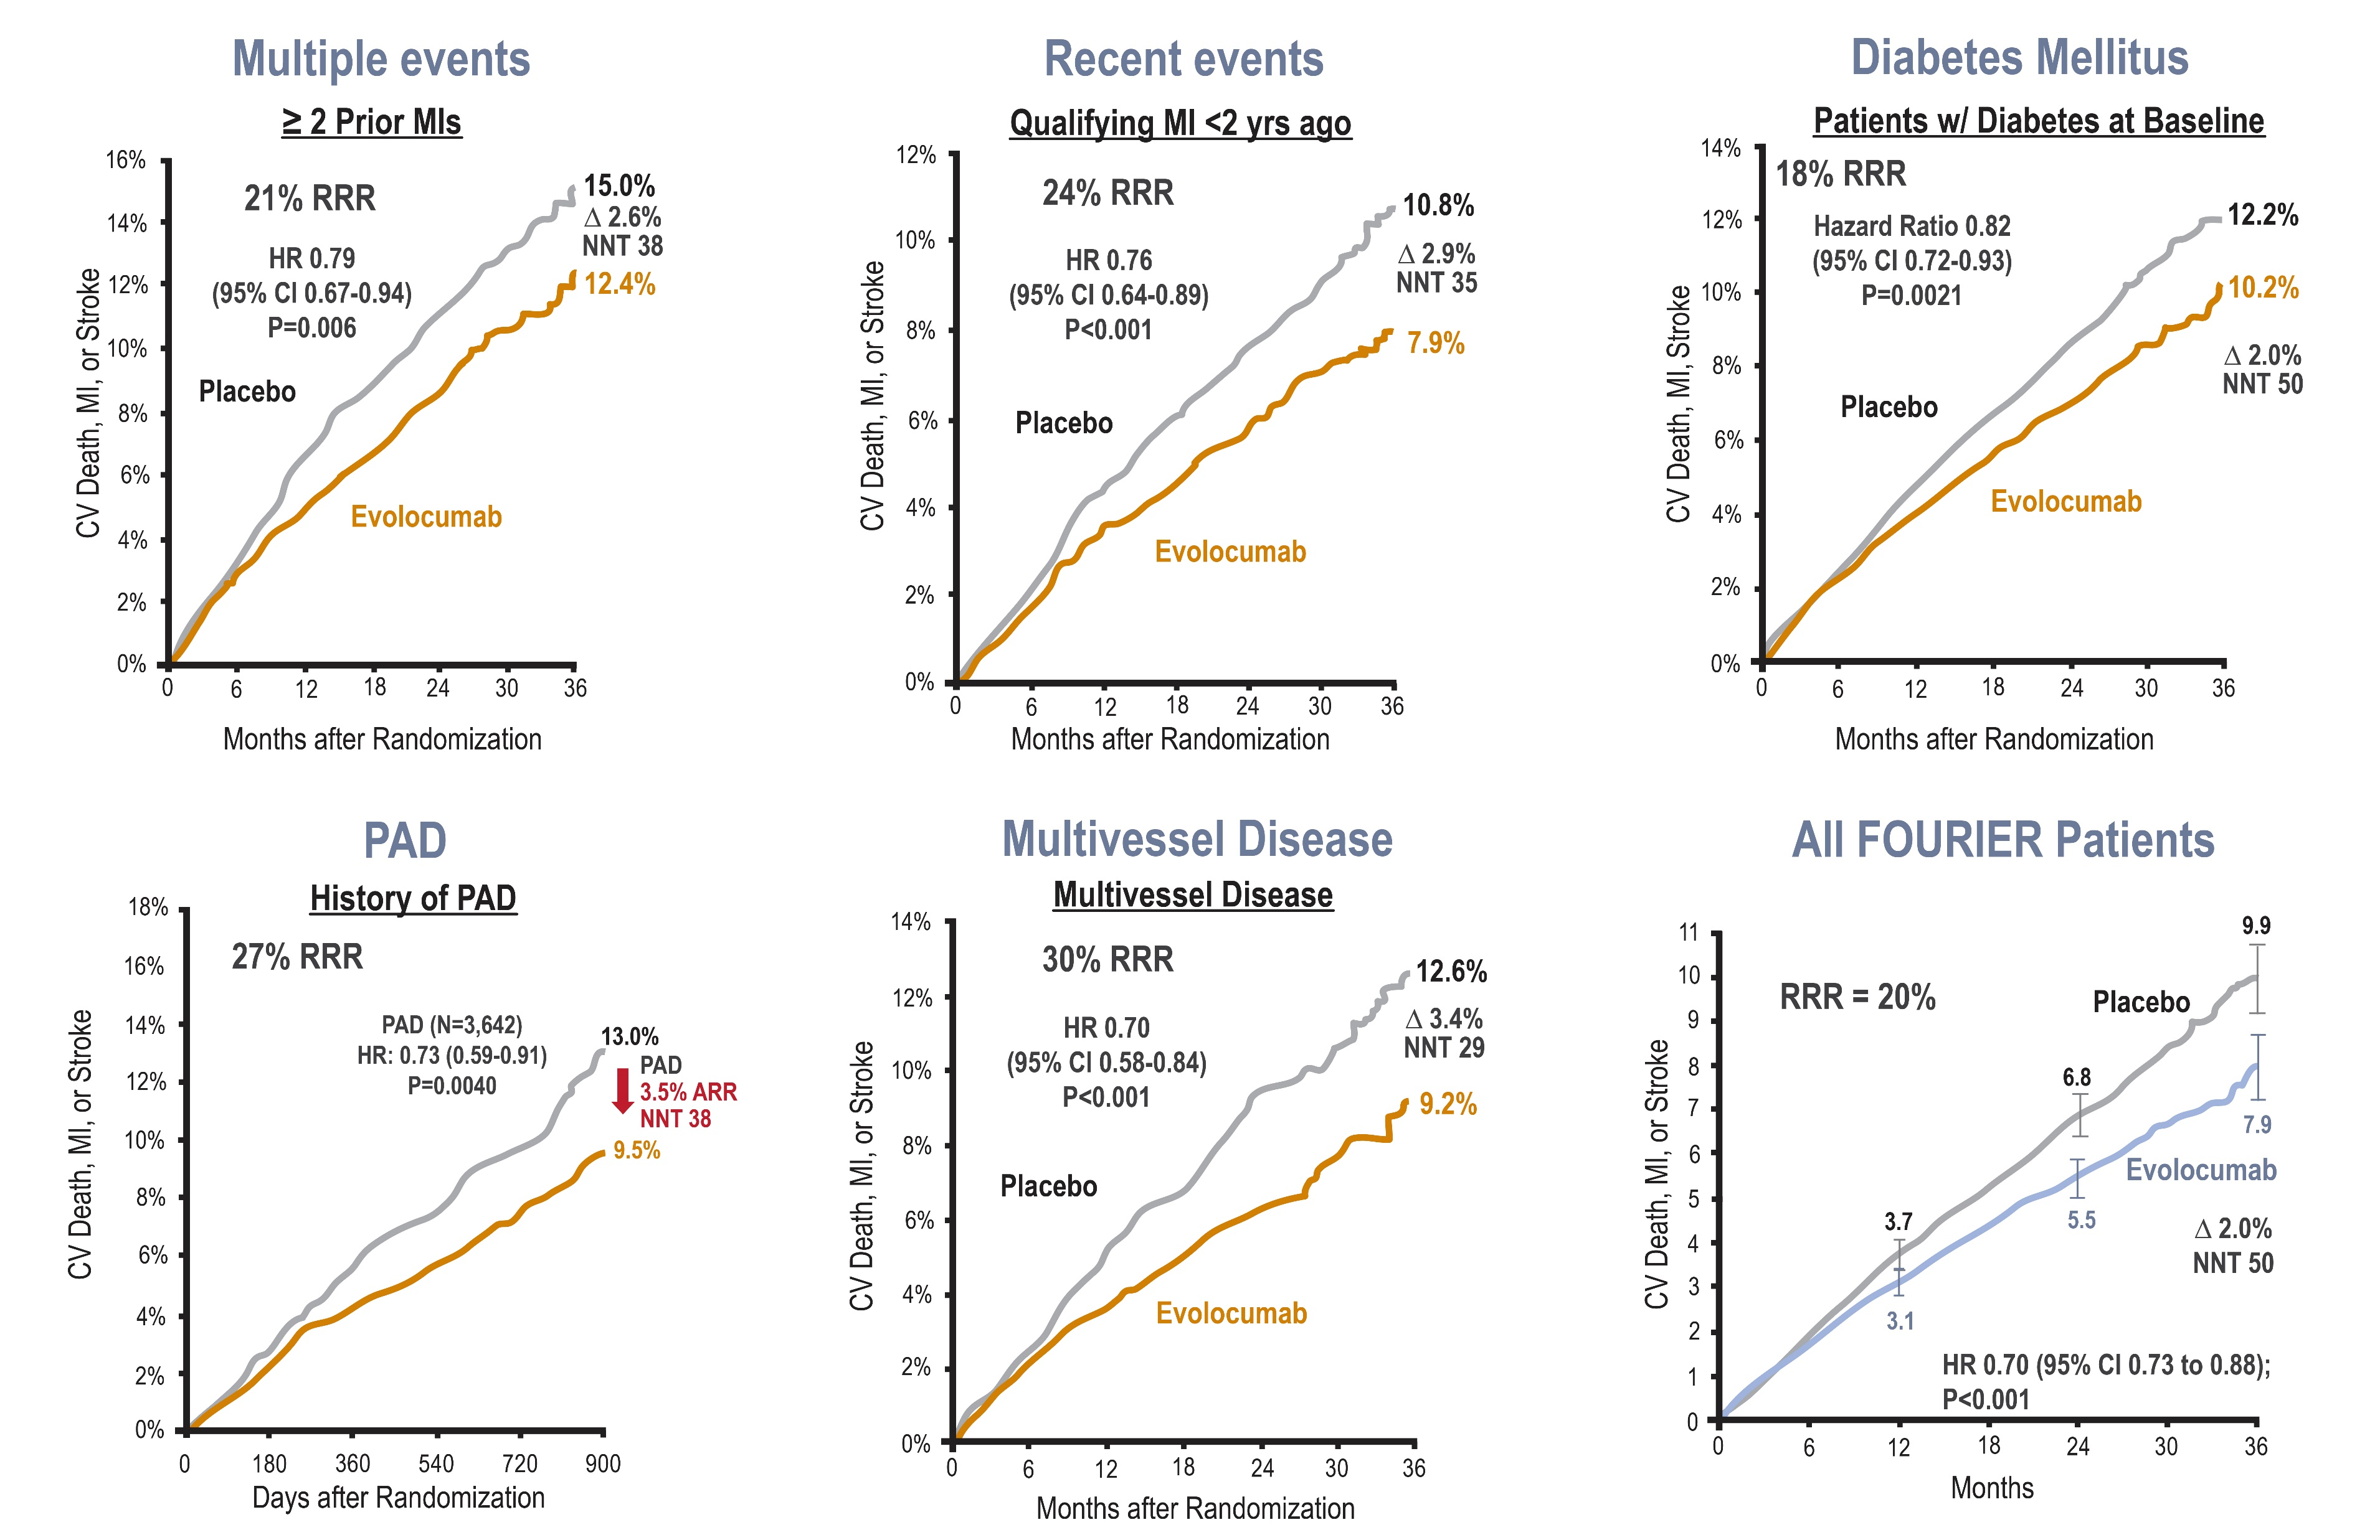
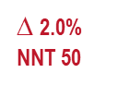
FOURIER Trial
Multiple High-Risk Patient Population Sub-Analysis
∆ 2.6% NNT 38
∆ 2.9% NNT 35
∆ 2.0% NNT 50
PAD
3.5% ARR
NNT 28
∆ 3.4% NNT 29
HR 0.80 (95% CI 0.73 to 0.88);
P<0.001
Sabatine MS, et al . AHA 2017 Poster

Slide 61
ODYSSEY Outcomes
Percent of Patients Experiencing Specified Outcome
P = .0003
P = .006
P = .026
P = NS
P = NS
P = .01
P = .02
* Composite of CHD death, non-fatal MI, ischemic stroke, unstable angina requiring hospitalization
Schwartz GG, et al. N Engl J Med. 2018:379:2097-2107

Slide 62
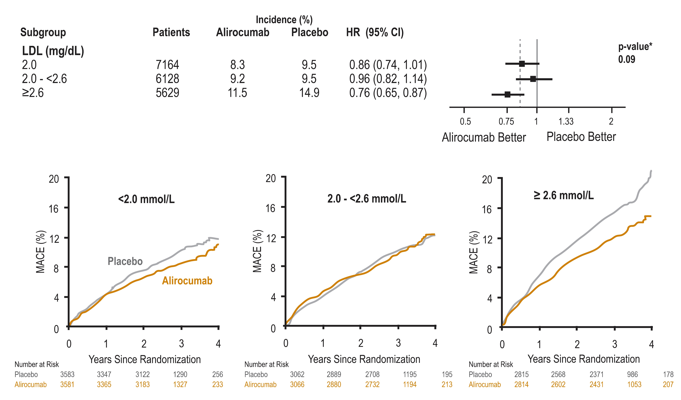
ODYSSEY Outcomes
Primary Efficacy in Main Prespecified Subgroups
Schwartz GG, et al. N Engl J Med. 2018:379:2097-2107

Slide 63
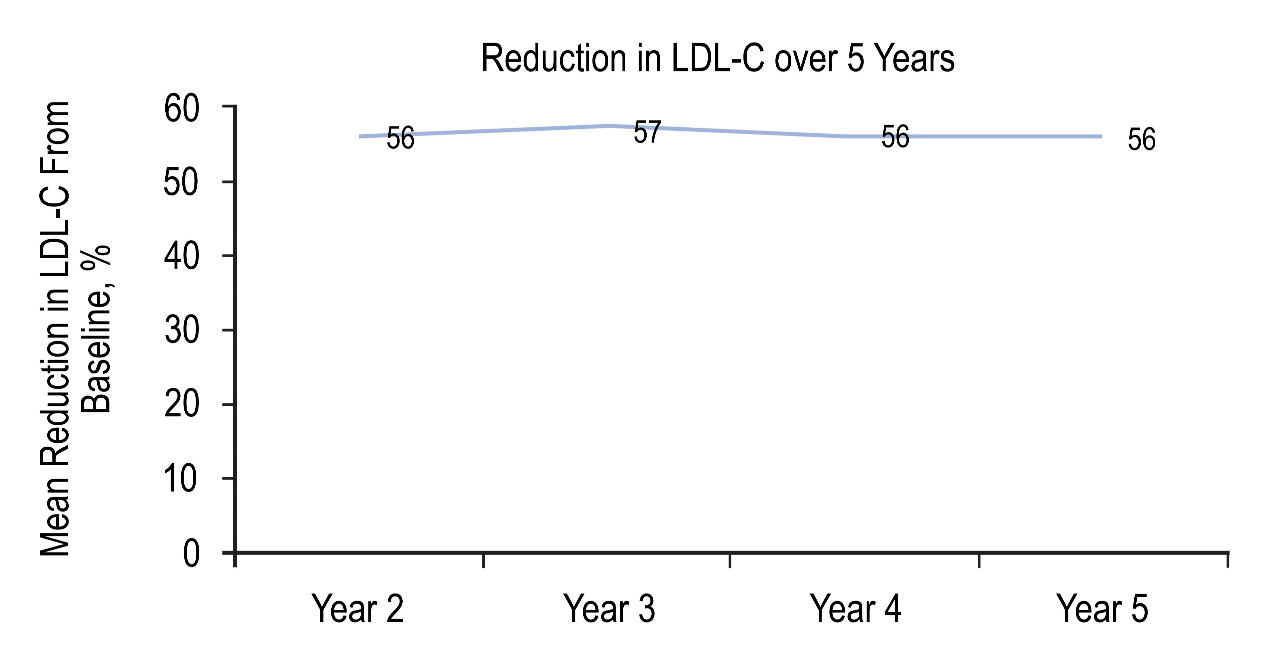
OSLER-1 Trial
OSLER-1 trial demonstrates consistent efficacy and safety of evolocumab over 5 years in patients with hypercholesterolemia
Baseline Characteristics:
48% male
52% female
3.6 mmol/L baseline LDL-C
Discontinued evolocumab due to AEs: 1.4% per year
4 instances of binding antibodies (2 SOC, 2 evolocumab)
No neutralizing antibodies detected over 5 years
Koren MJ, et al. AHA 2018. Abstract 118.
Notes:
Speaker Notes:
In the first year of the trial, Koren and colleagues randomly assigned patients in a 2:1 ratio to open-label treatment with evolocumab 420 mg per month plus standard-of-care treatment compared with standard-of-care treatment only. More patients (n = 882) were enrolled in the evolocumab arm compared with the standard-of-care treatment arm (n = 442). After the first year, all patients received extended, monthly evolocumab therapy plus standard-of-care treatment. The researchers examined the impact of evolocumab on lipids and safety outcomes, including antidrug antibodies, over the 5-year study period.
Treatment with evolocumab decreased median LDL cholesterol by 61% in year 1, 59% in year 2, 59% in year 3, 59% in year 4 and 58% in year 5. The analysis included 818 patients in year 1, 1,122 patients in year 2, 1,059 patients in year 3, 1,012 patients in year 4 and 870 patients in year 5.
Adverse events occurred in 79% of patients in year 1, 74% of patients in year 2, 71% of patients in year 3, 67% of patients in year 4 and 65% of patients in year 5. Serious adverse events occurred in 7%, 7%, 8%, 7% and 7%, respectively, of patients over the same time period. Adverse events that resulted in drug discontinuation occurred in 2.8%, .8%, 1.3%, 1% and .2% of patients each year from years 1 to 5.
Transiently positive tests for binding antidrug antibodies during year 1 were seen in two patients in the standard-of-care arm and two patients in the evolocumab arm. There were no subsequent or novel reports of binding or neutralizing antidrug antibodies noted after that point, according to Koren and colleagues.
“In OSLER-1, the longest study of a PCSK9 inhibitor to date, evolocumab consistently reduced LDL cholesterol with no increase in adverse events over time and no neutralizing antibodies,

Slide 64
.
PCSK9 Inhibitors and Their Indications
Alirocumab¹
Prevention of Cardiovascular Events
indicated in combination with a maximum tolerated dose of a statin, with or without other lipid lowering therapies, to reduce the risk of myocardial infarction, ischemic stroke, and unstable angina requiring hospitalization in adults with established cardiovascular disease.
Primary Hyperlipidemia
indicated in combination with a maximum tolerated dose of a statin, with or without other lipid lowering therapies, to reduce the risk of myocardial infarction, ischemic stroke, and unstable angina requiring hospitalization in adults with established cardiovascular disease.
indicated for the reduction of low-density lipoprotein cholesterol (LDL-C) in adults with primary hyperlipidemia (heterozygous familial and non-familial):
As an adjunct to diet and statin therapy, with or without other lipid-lowering therapies;
As an adjunct to diet, as monotherapy or in combination with other non-statin lipid modifying therapies, in patients for whom a statin is contraindicated
Evolocumab²
Prevention of Cardiovascular Events
Adjunct to diet and standard of care therapy (including moderate- to high-intensity statin therapy alone or in combination with other lipid-lowering therapy), to reduce the risk of myocardial infarction, stroke, and coronary revascularization in adult patients with atherosclerotic cardiovascular disease.
Primary Hyperlipidemia (including Heterozygous Familial Hypercholesterolemia)
indicated for the reduction of elevated low-density lipoprotein cholesterol (LDL-C) in adult patients with primary hyperlipidemia (including heterozygous familial hypercholesterolemia):
as an adjunct to diet and statin therapy, with or without other lipid-lowering therapies, in patients who require additional lowering of LDL-C
as an adjunct to diet, alone or in combination with non-statin lipid-lowering therapies, in patients for whom a statin is contraindicated
Homozygous Familial Hypercholesterolemia
adjunct to diet and other LDL-lowering therapies (e.g., statins, ezetimibe, LDL apheresis) in adult patients and adolescent patients aged 12 years and over with homozygous familial hypercholesterolemia (HoFH) who require additional lowering of LDL-C.
ASCVD, atherosclerotic cardiovascular disease; HeFH, heterozygous familial hypercholesterolemia; HoFH, homozygous familial hypercholesterolemia; LDL-C, low density lipoprotein cholesterol; PCSK9, proprotein convertase subtilisin kexin type 9.; MI, myocardial infarction
1. Alirocumab Canadian Product Monograph, August 13, 2019; 2. Evolocumab Canadian Product Monograph, June 11, 2019
Notes:
Speaker Notes:

Slide 65
Improving Outcomes in Our Patients

Slide 66
When to Consider Additional Lipid Lowering Therapy
LDL-C<15-20% away from target:
addition of ezetimibe is likely to achieve target
LDL-C> 20% away from target:
no add-on drug other than a PCSK9 inhibitor is likely to achieve target
Use clinician judgement and patient-centered approach when adding non-statin therapy (i.e. ezetimibe first, PCSK9 inhibitors, both).
Statin-Indicated Conditions
(genetic dyslipidemia)
Discuss behavioral modifications
Initiate Statin Treatment : Treat to Target Approach
LDL-C <2.0 mmol/L or >50% reduction or apoB <0.8 g/L or
non HDL-C <2.6 mmol/L
LDL-C >50% reduction
Target achieved on maximally tolerated dose?
NO
NO
Discuss add-on therapy with patient
ADD
ON
ADD
ON
Add-on Therapy
Ezetimibe as 1st line (BAS as alternative)
PCSK9 inhibitors as 2nd line (add on to other drugs)
Ezetimibe (or BAS) or PCSK9 inhibitors
Anderson and al., Can Journal of Cardiol, 32 (11); 1263-82.
Apo, apolipoprotein; BAS, bile acid sequestrant; LDL-C, low-density lipoprotein cholesterol; non-HDL-C, non-high-density lipoprotein cholesterol.
Notes:
Speaker Notes:
In the first year of the trial, Koren and colleagues randomly assigned patients in a 2:1 ratio to open-label treatment with evolocumab 420 mg per month plus standard-of-care treatment compared with standard-of-care treatment only. More patients (n = 882) were enrolled in the evolocumab arm compared with the standard-of-care treatment arm (n = 442). After the first year, all patients received extended, monthly evolocumab therapy plus standard-of-care treatment. The researchers examined the impact of evolocumab on lipids and safety outcomes, including antidrug antibodies, over the 5-year study period.
Treatment with evolocumab decreased median LDL cholesterol by 61% in year 1, 59% in year 2, 59% in year 3, 59% in year 4 and 58% in year 5. The analysis included 818 patients in year 1, 1,122 patients in year 2, 1,059 patients in year 3, 1,012 patients in year 4 and 870 patients in year 5.
Adverse events occurred in 79% of patients in year 1, 74% of patients in year 2, 71% of patients in year 3, 67% of patients in year 4 and 65% of patients in year 5. Serious adverse events occurred in 7%, 7%, 8%, 7% and 7%, respectively, of patients over the same time period. Adverse events that resulted in drug discontinuation occurred in 2.8%, .8%, 1.3%, 1% and .2% of patients each year from years 1 to 5.
Transiently positive tests for binding antidrug antibodies during year 1 were seen in two patients in the standard-of-care arm and two patients in the evolocumab arm. There were no subsequent or novel reports of binding or neutralizing antidrug antibodies noted after that point, according to Koren and colleagues.
“In OSLER-1, the longest study of a PCSK9 inhibitor to date, evolocumab consistently reduced LDL cholesterol with no increase in adverse events over time and no neutralizing antibodies,

Slide 67
Re-Evaluating LDL-C Targets
The lower the LDL-C achieved, the greater the reduction in CV risk
Clinicians need to start re-evaluating LDL-C targets for patients with known ASCVD and other risk factors
Need to reduce LDL-C levels < 1.0 mmol/L where the data show there is a CV benefit at these levels
CV Benefit
LDL-C Reduction

Slide 68

DISCUSSION
Which patients do you believe benefit most
from PCSK9 Inhibition?

Slide 69
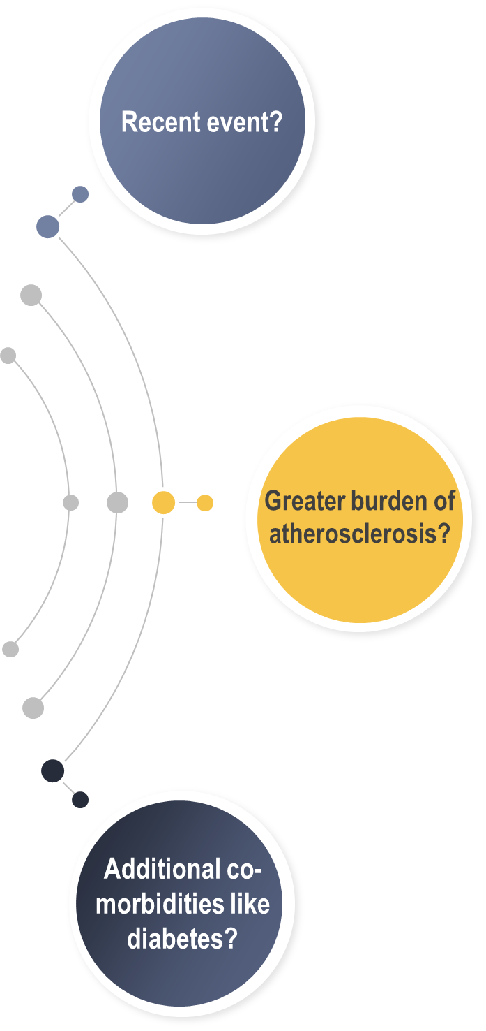
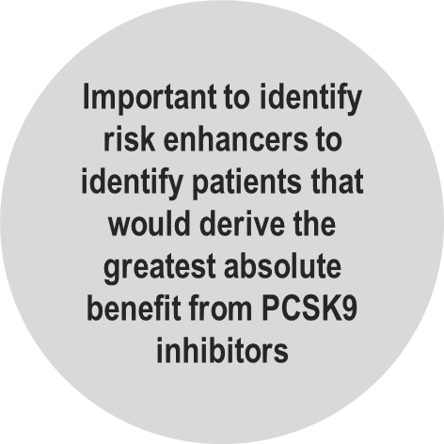
Identifying which Patient Will Benefit most from
PCSK9 Inhibition
Need to look beyond whether a patient has established CVD or not
i.e. multiple events

Slide 70
DISCUSSION
Which patients do you believe would benefit most from “Lowest is Best Strategy”?

Slide 71
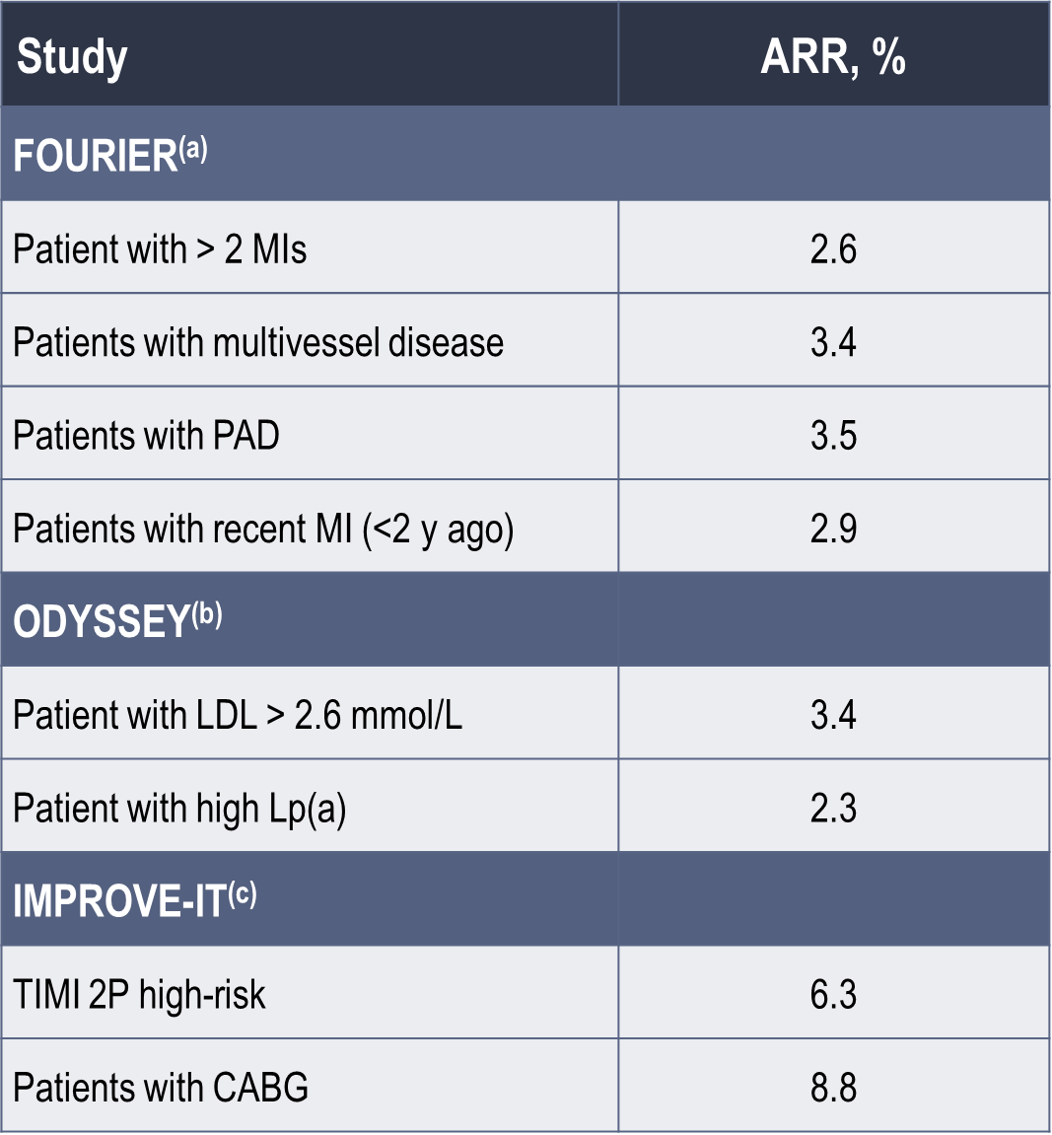
Who will Benefit most from “Lowest is Best” Strategy
Murphy SA, et al. The FOURIER Trial. AHA Scientific Sessions 2017
ODYSSEY; Bays H, et al. J Am Heart Assoc. 2017;6:e005639
IMPROVE-IT; Cannon C, et al. N Engl J Med. 2015;372:2387-2397

Slide 72
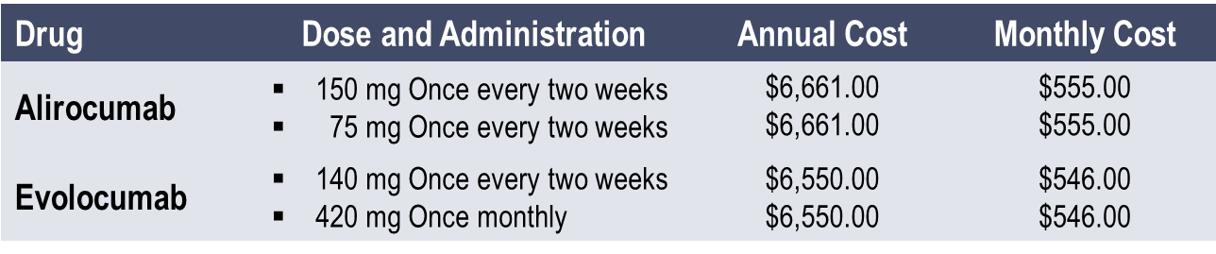
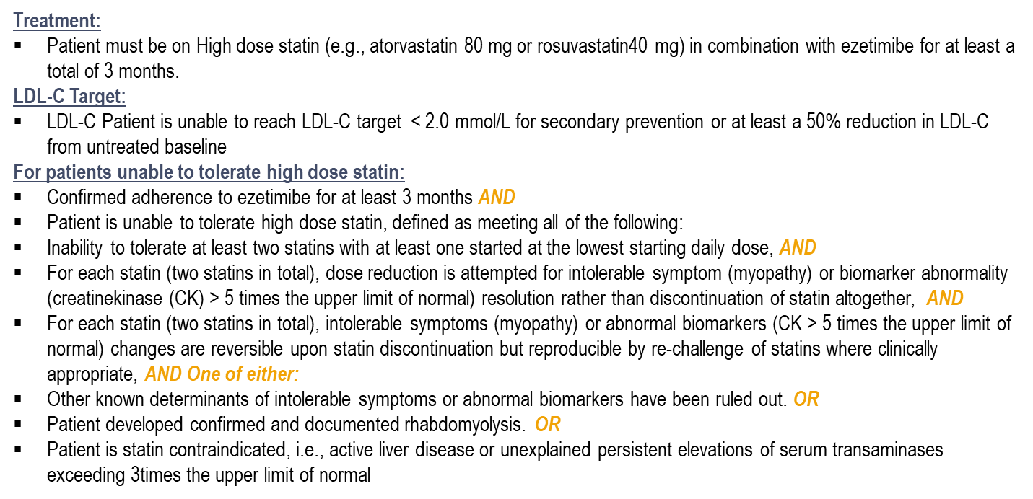
PCSK9 Inhibitors – Cost and Access
Cost: Alirocumab and Repatha have very similar annualized costs
Provincial Coverage: PCSK9i are, for the most part, covered on provincial formularies for patients with a definite or probable diagnosis of HeFH using the Simon Broome or Dutch Lipid Network criteria or genetic testing*
Alirocumab covered by 5 out of 10 provinces (excluding BC, MB, QC, NS, NL, PEI)
Evolocumab covered by 8 out of 10 provinces (excluding NL & PEI)
Private Coverage:
Alirocumab and Evalocumab are covered for > 90% of patients with ASCVD and FH
Access Options:
Alirocumab and Evalocumab are supported by Patient support programs, My Praluent and RepathaREADY
These patient support programs will help secure reimbursement, offer patient counselling, treatment information and manage renewals / adherence.
Co-Pay options are also provided by these patient support programs
www.formulary.health.gov.on.ca/formulary
www.health.gov.on.ca/en/pro/programs/drugs/drug...stat.../repatha.pdf
* Ontario Provincial Reimbursement Criteria forHeFH used as the example

Slide 73
Overcoming Access Barriers to PCSK9 Inhibitors
01
Fill in the requisite information appropriately to get reimbursement for our patients
02
Documentation of LDL-C history and possible statin intolerance
03
Documentation of high-risk features and co-morbidities
Baum SJ, et al. Clin Cardiol. 2017;40:243-254

Slide 74
Summary
Despite best-evidence-based treatment, high-risk and very high risk patients continue to experience CVD events
Failure to attain guideline-recommended LDL-C goals is an important component of this residual CVD risk
Additional LDL-C lowering options are needed to address this unmet clinical need
The data from clinical trials with PCSK9 inhibition demonstrate efficacy and safety of LDL-C lowering by an additional 60% on top of statin ± ezetimibe therapy resulting in further reductions in MACE

Slide 75
Back-Up Slides

Slide 76
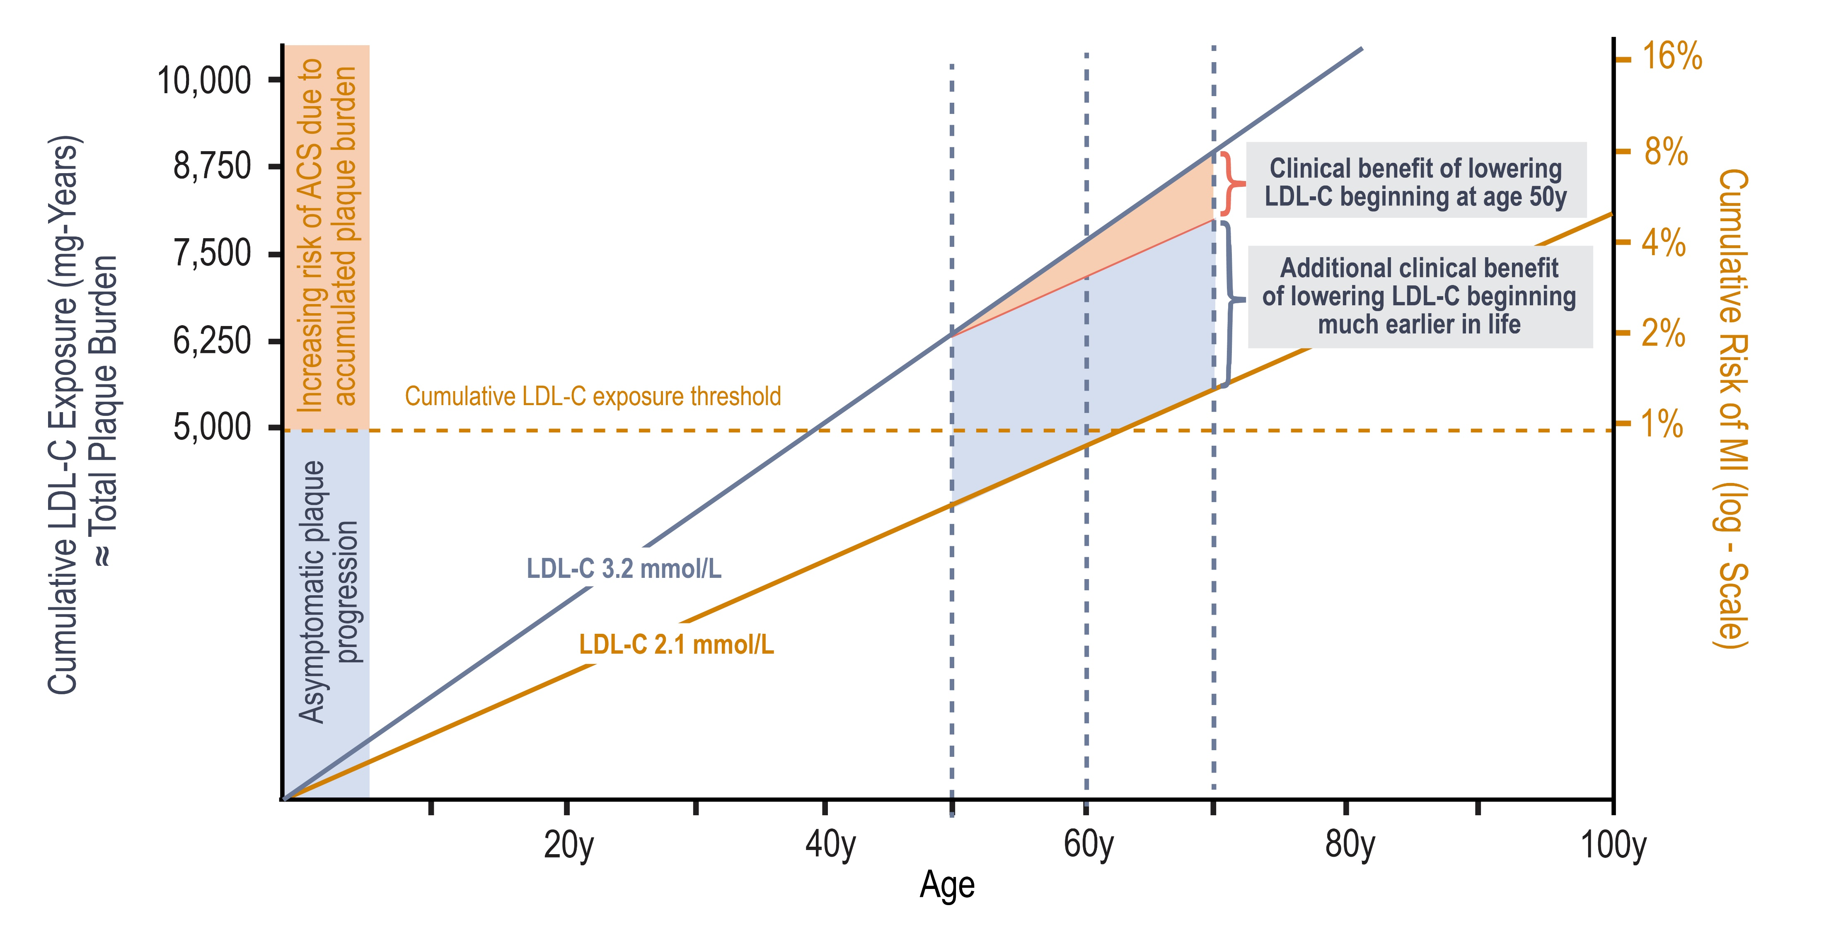
Effect of Primary and Primordial Prevention on Progression of Atherosclerosis and Risk of Acute Cardiovascular Events
Cumulative LDL-C Exposure (mmol-Years)
≈ Total Plaque Burden
259
207
194
162
129
Ference BA, et al. J Am Coll Cardiol 2018;72:1141–56
Notes:
Speaker Notes:
The solid blue line is a low-density lipoprotein cholesterol (LDL-C) level of 120 mg/dl 3.23 mmol/L. The orange line is a low-density lipoprotein cholesterol
level of 80 mg/dl 2.06 mmol/L. The solid orange line represents lowering low-density lipoprotein cholesterol by 40 mg/dl (approximately 1 mmol/l) from
120 to 80 mg/dl beginning at age 50 years and extending to age 70 years. Cumulative low-density lipoprotein cholesterol exposure is derived
by multiplying age by plasma low-density lipoprotein cholesterol. Cumulative risk of myocardial infarction (MI) is measured on the log
(“doubling”) scale. The orange shaded area represents a 25% relative risk reduction in myocardial infarction (MI) as a result of lowering
low-density lipoprotein cholesterol by 40 mg/dl from 120 to 80 mg/dl from age 50 to 70 years. During this period of treatment, however,
the “residual” risk of myocardial infarction remains high because of the high accumulated total plaque burden (as estimated by the cumulative
exposure to low-density lipoprotein cholesterol). The blue shaded area represents the additional clinical benefit that could be achieved by
maintaining low-density lipoprotein cholesterol at 80 mg/dl throughout life (which essentially eliminates the “residual” risk of myocardial
infarction). ACS ¼ acute coronary syndrome.

Slide 77
Clinical Tips for Therapeutic Management of PCSK9 Inhibitors
First patient-administered injection should be performed in office after education
Offer to have second injection performed in office as well if the patient has ongoing reservations
Caution with latex allergy (evolocumab)
Common mistakes during injection
Expediting the warming phase (do not use microwave)
Improper storage
Failing to discard the pen
Rubbing the site after injection is complete
Pulling the pen away before the injection has been made (15-20 seconds)
Not pushing the down firmly such that the yellow tip is still visible
If LDL-C < 0.4 mmol/L → switched to placebo
Alirocumab Canadian Product Monograph, September 20, 2018;
Evolocumab Canadian Product Monograph, June 11, 2019

Slide 78
Clinicians’ Corner:
Additional benefit of PCSK9 inhibition in high-risk patients after myocardial infarction

Slide 79
In the FOURIER trial, which of the following subgroups of patients with prior myocardial infarction (MI) had the greatest relative risk reduction?
Qualifying MI >2 years ago
Multivessel Disease
1 prior MI
Universal MI Type 2

Slide 80
Additional Benefit of PCSK9 Inhibition in High-Risk Patients after Myocardial Infarction
A FOURIER Subanalysis
Primary endpoint: composite of CV death, MI, stroke, coronary revascularization, or hospitalization for unstable angina; Recent MI: within the past 2 years; multi-vessel disease: ≥40% stenosis in ≥2 large vessels
PCSK9: proprotein convertase subtilisin-kexin type 9; FOURIER: Further cardiovascular Outcomes Research with PCSK9 Inhibition in patients with Elevated Risk; MI: myocardial infarction;
Sabatine et al. Circulation 2018

Slide 81
DISCUSSION
What are the implications for clinical practice?

Slide 82
Summary
Patients
(1) closer to their most recent MI,
(2) with multiple prior MIs, or
(3) with multivessel disease
are at 34-90% ↑ risk for major vascular events
These patients experience substantial:
relative risk reductions (21-30%) and
absolute risk reductions (2.6-3.4% over 3 years) with intensive LDL-C lowering with PCSK9i
These readily ascertainable clinical features offer one approach to tailoring therapy

Slide 83
Clinicians’ Corner: Diabetes & ASCVD

Slide 84
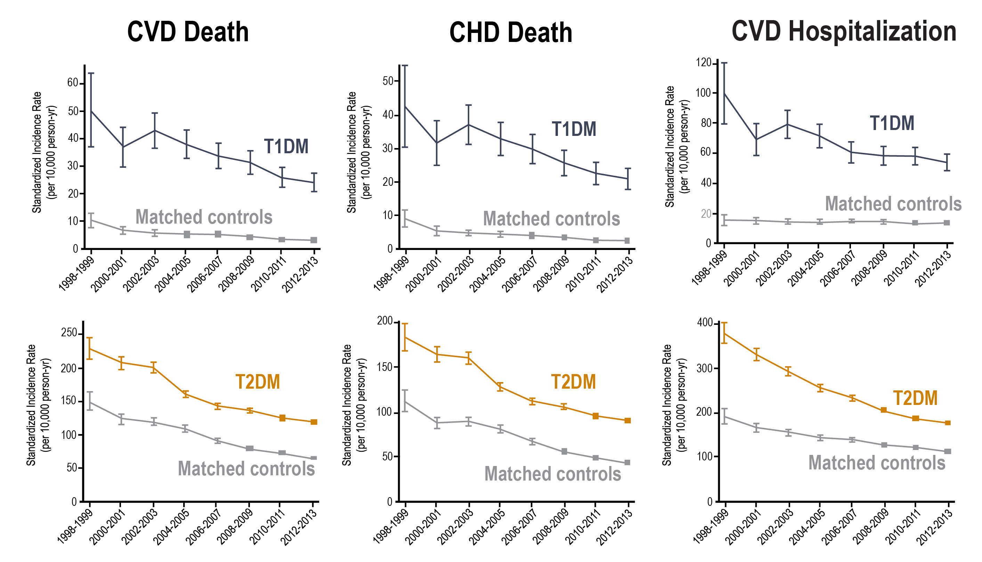
Cardiovascular Events Remain High in
Individuals with Diabetes

Slide 85
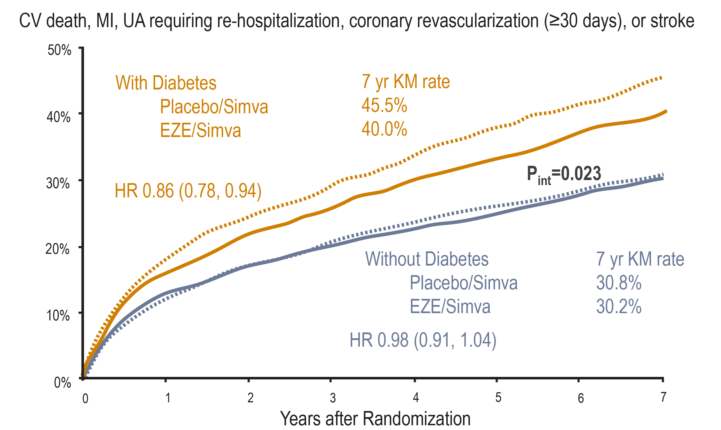
IMPROVE-IT Ezetimibe Add-on to Simvastatin was Beneficial in Persons with ACS and Diabetes

Slide 86
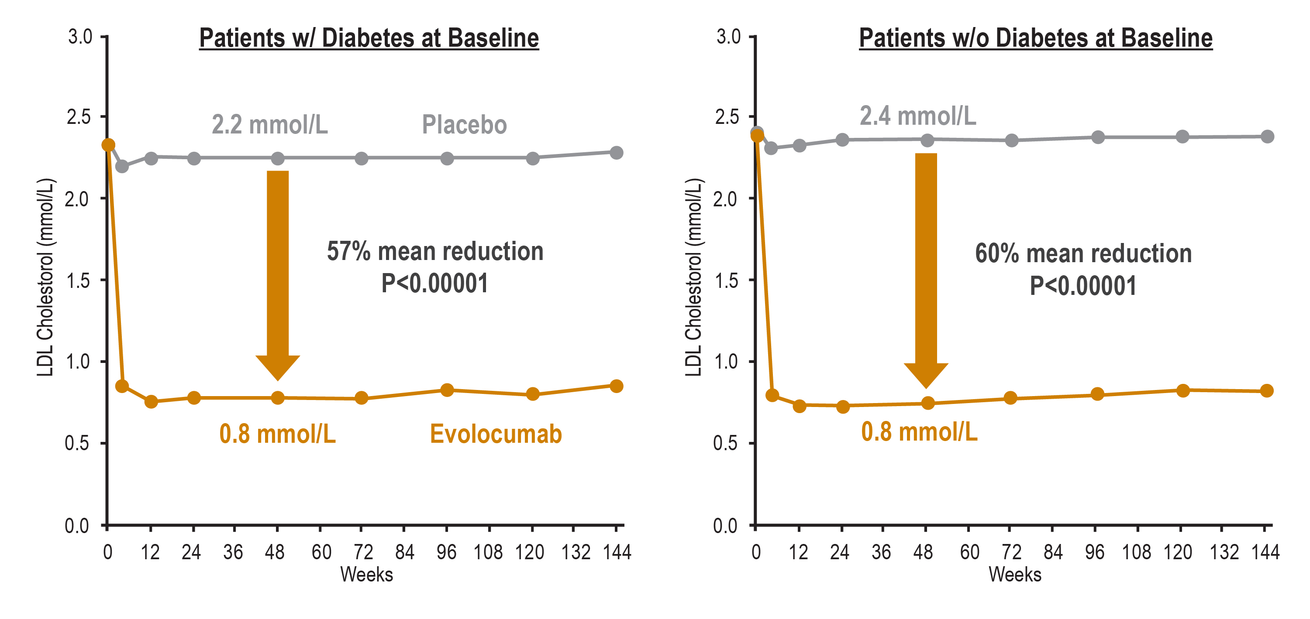
FOURIER: LDL-C Reduction with Evolocumab

Slide 87
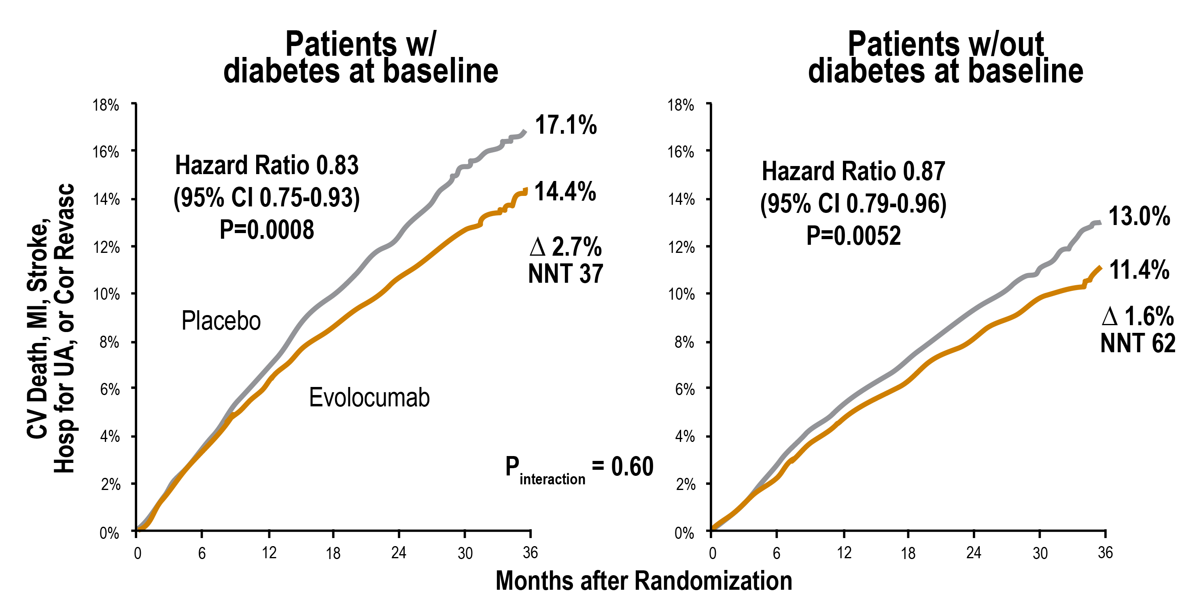
FOURIER:
Effect of Evolocumab on Primary Endpoint

Slide 88
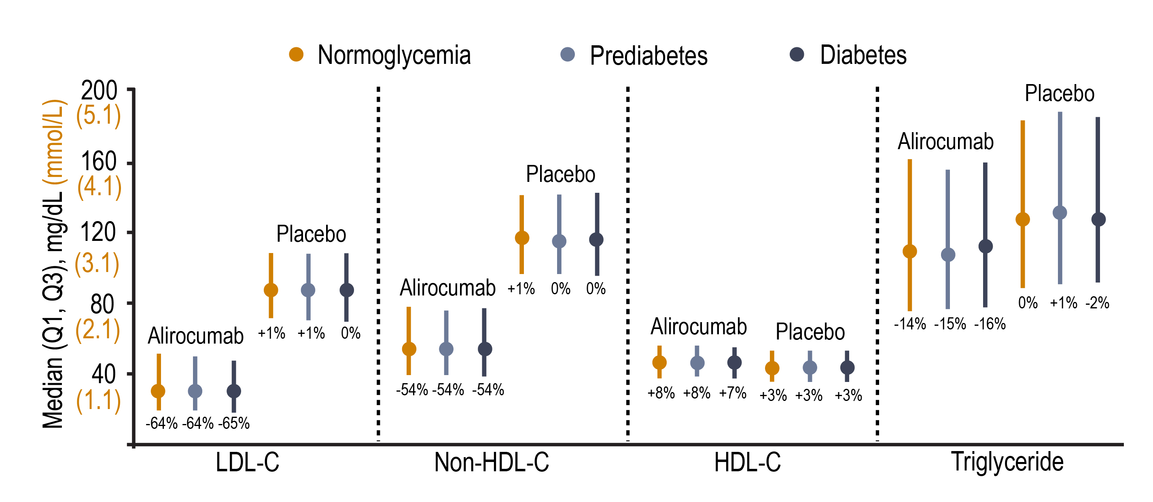
ODYSSEY OUTCOMES Lipids at 16 Weeks After Randomization¹
Median percent change from baseline presented below each bar
*Intention-to-treat analysis
Notes:
Speaker Notes:
Lipid values after 16 weeks post randomization:
Regardless of glucometabolic status, alirocumab reduced consistently lipid parameters, resulted in lower levels of LDL-C, non-HDL-C and triglycerides levels, compared with those who received placebo.

Slide 89
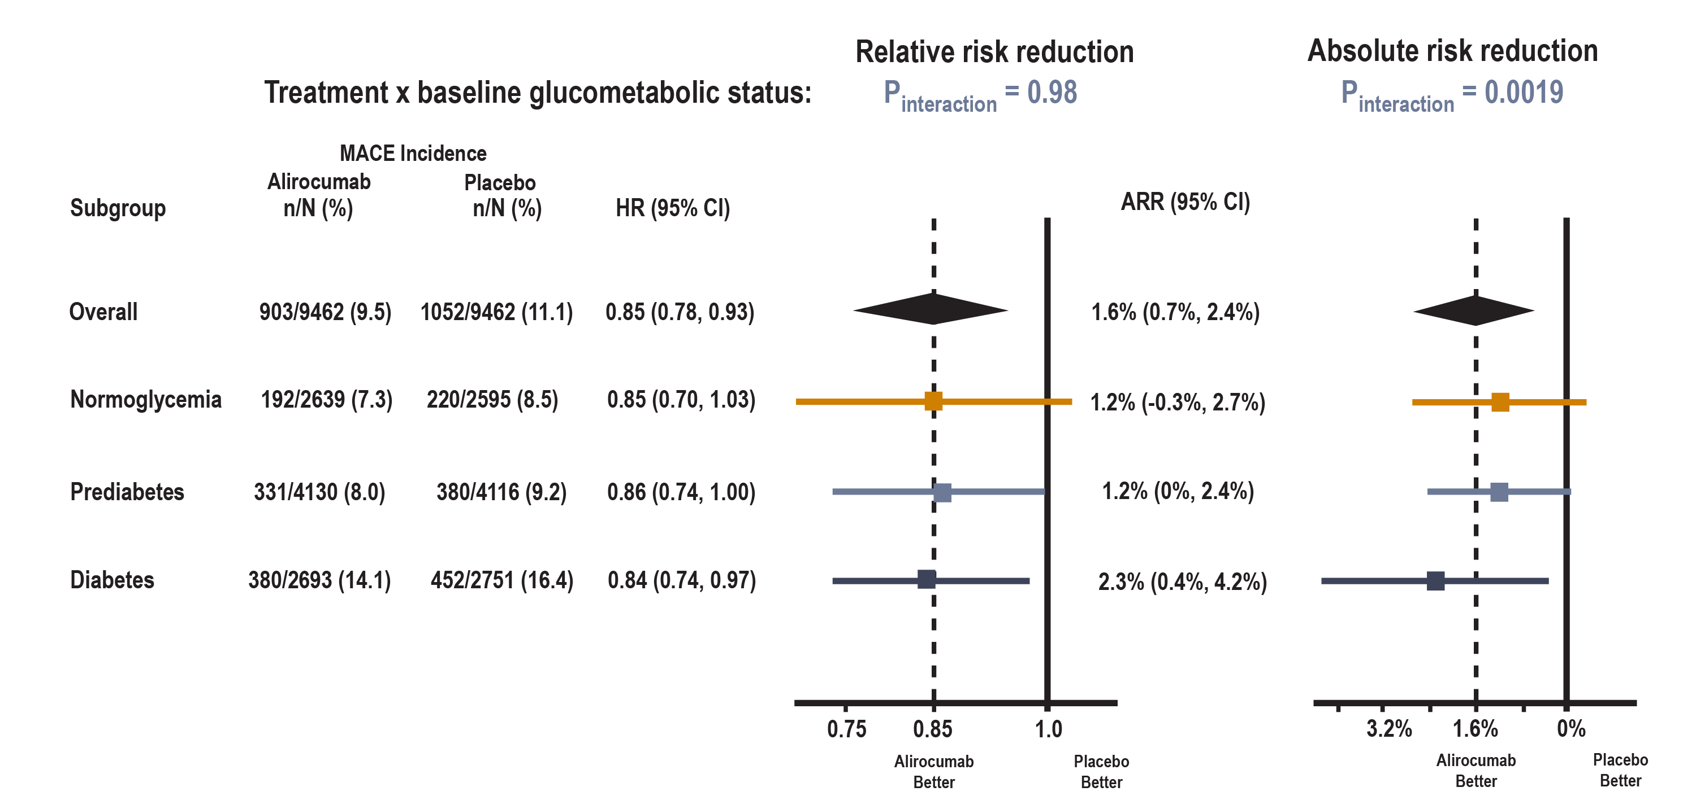
ODYSSEY OUTCOMES Relative and Absolute Risk Reduction with Alirocumab By Glucometabolic Status
Median (Q1, Q3) follow-up: 2.8 (2.3, 3.4) years
Notes:
Speaker Notes:
Alirocumab produces a similar and consistent relative risk reduction (p_{interaction} =0.98) and greater significant absolute risk reduction in MACE in patients with DM compared to those without DM (significant p_{interaction} =0.0019)

Slide 90
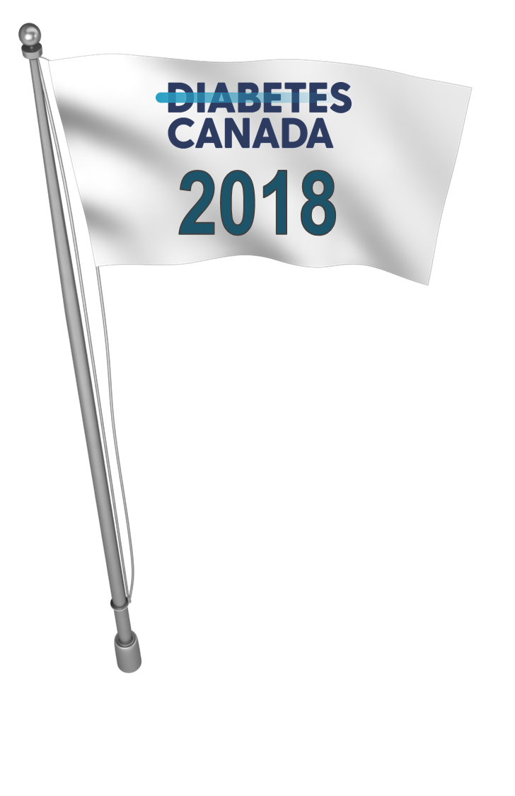
Recommendations for
Lipid Management in Diabetes
For people with diabetes with indications for lipid-lowering therapy, treatment should be initiated with a statin¹ to achieve LDL-C consistently <2.0 mmol/L² or >50% reduction of LDL-C from baseline³.
Alternative targets and respective goals are apo B <0.8 g/L and non-HDL-C <2.6 mmol/L⁴ .
1 [Grade A, Level 1]
2 [Grade C, Level 3]
3 [Grade D, Consensus]
4 [Grade C, Level 3]

Slide 91
Summary
Statin monotherapy may not achieve targets in all patients
Previous add-ons to statin are suboptimal
PCSK9 inhibitors appear to have similar efficacy and safety in individuals with and without diabetes (with greater absolute risk reduction) and with no apparent adverse effects on glycemia

